Slide 1
Design Patterns (Details)
Source of most materials:
Xiwei Xu, Ingo Weber, and Mark Staples. Architecture for Blockchain Applications. Springer, 2019

Slide 2
Pattern Collection (Chapter 7)
Interaction with External World
Centralized Oracle
Decentralized Oracle
Data Management
Encrypting On-chain Data
Voting
Tokenisation
Security
Multiple Authorization
X-confirmation
Security Deposit
Contract Structural Patterns
Contract Registry
Embedded Permission
Data Contract
Factory Contract
Incentive Execution
Deployment
Semi-dapp
dapp
Legal and Smart Contract Pair
Reverse Oracle
Off-chain Data Storage
State Channel
Dynamic Authorization
Mixed on and off-chain
Purely on-chain
Notes:
Overview of pattern collections in five categories, including
On-chain and off-chain is the fundamental design decision
Oracles are offchain, legal and smart contract pair on chain
One by one discuss

Slide 3
Blockchain-based Application Pattern Collection: Interaction with External World

Slide 4
Pattern Collection (Chapter 7)
Interaction with External World
Centralized Oracle
Decentralized Oracle
Data Management
Encrypting On-chain Data
Voting
Tokenisation
Security
Multiple Authorization
X-confirmation
Security Deposit
Contract Structural Patterns
Contract Registry
Embedded Permission
Data Contract
Factory Contract
Incentive Execution
Deployment
Semi-dapp
dapp
Legal and Smart Contract Pair
Reverse Oracle
Off-chain Data Storage
State Channel
Dynamic Authorization
Mixed on and off-chain
Purely on-chain
Notes:
Overview of pattern collections in five categories, including
On-chain and off-chain is the fundamental design decision
Oracles are offchain, legal and smart contract pair on chain
One by one discuss

Slide 5
Pattern 1: Centralized Oracle 1/3
Summary
Introduce the state of external systems into the closed blockchain execution environment through a single centralized oracle
Context
Blockchain-based applications might need to interact with other external systems
Validation of transactions might depend on external state
Problem
Blockchain is a self-contained (“closed-world”) execution environment
Smart contracts are pure functions that can’t access external systems
Forces
Closed environment
Secure, isolated execution environment
Connectivity
General-purpose applications might require information from external systems
Long-term availability and validity
External state used to validate a transaction may change or even disappear
Notes:
Context: From the software architecture perspective, blockchain can be viewed as a component or connector within a large software system.
In the case the blockchain is used as a distributed database for more general purposes other than financial services,
the applications built on blockchain might need to interact with other external systems.
Thus, the validation of transactions on blockchain might depend on states of external systems.
Problem: The execution environment of a blockchain is self-contained.
It can only access information present in the data and transactions on the blockchain.
Smart contracts running on blockchain are pure functions by design.
The state of external systems are not directly accessible to smart contracts.
Yet, function calls in smart contracts sometimes need to access state of the external world.
Forces
Closed environment. Blockchain is a secure, self-contained environment, which is isolated from external systems.
Smart contracts on blockchain cannot read the states of the external systems.
Connectivity. In addition to the data found on the blockchain, general-purpose applications might require information from external systems.
For example, a parcel tracking application needs context information like geo-location information, a gambling application might need result of a football game from a Web API.
Long-term availability and validity. While transactions on blockchain are immutable,
the external state used to validate a transaction may change or even disappear after the transactions were originally appended to the blockchain.

Slide 6
Pattern 1: Centralized Oracle 2/3
Solution
Oracle assists in evaluating conditions that cannot be expressed in a smart contract
Oracle injects the result to the blockchain in a transaction signed using its own key pair
Validation of transactions is based on the authentication of the oracle
Consequences
Benefits
Connectivity: Closed environment of blockchain is connected with external world through Oracle
Drawbacks
Trust: Oracle is trusted by all the participants
Validity: External states injected into the transactions can not be fully validated by miners
Long-term availability and validity: External state used to validate transaction changes after the transaction was originally appended to the blockchain
Notes:
Solution：To connect the closed execution environment of blockchain with the external world,
oracle is introduced to assist in evaluating conditions that cannot be expressed in a smart contract running within the blockchain environment.
An oracle is a trusted third party that provides the smart contracts with information about the external world.
When validation of a transaction depends on external state, the oracle is requested to check the external state and and inject the result to the blockchain in a transaction signed using its own key pair.
The validators (miner) take the result provided by the oracle into account when validating the transaction.
Through using oracle, the validation of transactions is based on the authentication of the oracle, rather than the external state.
Connectivity. The closed execution environment of blockchain is connected with external world through the oracle.
The applications based on blockchain can access external states through the oracle and use the external states to validate transactions.
Trust. Using oracle introduces a trusted third party into the system.
The oracle selected to verify the external state needs to be trusted by all the participants involved in relevant transactions.
Validity. The external states injected into the transactions can not be fully validated by miners.
Thus, when miners validate the transaction including external state, they rely on the oracle to check the validity of the information from external world.
Long-term availability and validity. It could happen that while transactions are immutable,
the external state used to validate them may change after the transactions were originally appended to the blockchain.

Slide 7
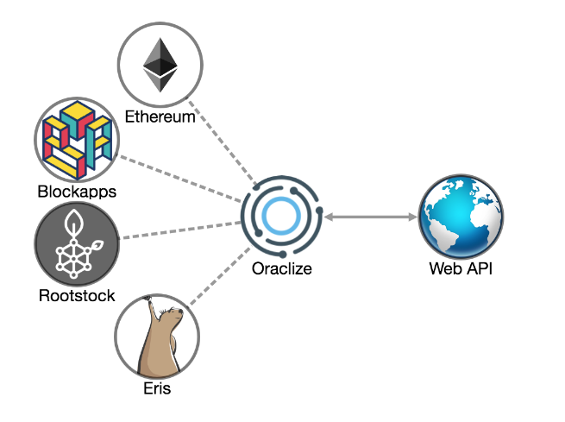


Pattern 1: Centralized Oracle 3/3
Related Patterns
Pattern 2. Decentralized Oracle
Pattern 4. Reverse Oracle
Known uses
Oraclize uses trusted hardware to directly fetch information from trusted execution environment (TEE)
Oracle in Bitcoin evaluates user-defined expressions based on the external state
Corda has a embedded oracle mechanism using Intel Software Guard Extension (SGX) for hardware attestation
Notes:
Oracle in Bitcoin is an instance of this pattern
Oracle is a server outside the Bitcoin blockchain network, which can evaluate user-defined expressions based on the external state.
Oraclize is a oracle service provider, which utilises trusted hardware to directly fetch information from external trusted execution environment (TEE).
Oraclize introduces three different proofs for fetching data from external data sources, namely, TLS-Notary, Ledger proof and Android proof.
Corda has a centralized oracle mechanism embedded in its platform. The oracle mechanism uses Intel Software Guard Extensions (SGX) for hardware attestation to prevent unauthorised access outside of the SGX environment..

Slide 8



Student Task
Take 30 seconds to think about applying this pattern for any use case you know about
Maybe exam registration?
Then we’ll discuss

Slide 9
Pattern 2: Decentralized Oracle 1/3
Summary
Introduce the state of external systems into the closed blockchain execution environment through decentralized oracle
Contexts
Blockchain-based applications might need to interact with other external systems
Validation of transactions relies on oracle to inject the external state
Problem
A centralized oracle introduces a single trusted third party
Forces
Reliability
Centralized oracle is a single point of failure
Variety of data sources
Static web page, physical sensor, input from a human
Multiple sources might come from a single authorized source
Notes:
Context: Similar as Pattern 1, In the case where blockchain is used as a distributed database for more general purposes other than financial services,
the applications built on blockchain might need to interact with other external systems.
the validation of transactions on blockchain relies on oracle to inject the states of external systems into blockchain.
Problem: The execution environment of a blockchain is self-contained. It can only access information present in the data and transactions on the blockchain.
Smart contracts running on blockchain are pure functions by design. The state of external systems are not directly accessible to smart contracts.
Yet, function calls in smart contracts sometimes need to access state of the external world.
However, a centralized oracle introduces a single trusted third party into the system, which might becomes a single point of failure.
Forces: Reliability. A centralized oracle becomes a single point of failure from architecture perspective.
If the status injected into the blockchain is a faulty status, then the whole system is unreliable.
Variety of data source. The data source(s) could be a static web page, physical sensor, component of a system or even input from a human.
Decentralized oracles request data from various sources.
Despite having multiple data sources, some information such as the owner of a property from different resources might ultimately come from a single authorised source.

Slide 10
Pattern 2: Decentralized Oracle 2/3
Solution
Decentralized oracle based on multiple servers and multiple data sources
Consensus on the external status, e.g.:
K-out-of-M threshold signature
Consequences
Benefits
Reliability
Risk from a single point of failure is reduced
Improves the likelihood of getting accurate external data
Drawbacks
Trust: All the oracles that verify the external state are trusted by all participants involved in transactions
Time: Get required information from multiple data sources and reach a consensus for the final result
Cost: increases with the number of oracles being used
Notes:
Solution: To improve trustworthiness of the oracle, a decentralized oracle mechanism is introduced,
which is based on multiple servers and multiple data sources. K-out-of-M threshold signature can be used by multiple oracles to reach a consensus on the status to be injected into the blockchain.
For example, a 3-out-of-5 signature scheme requires at least three or more oracles out of five oracles to sign on the same value for the value to be injected into the blockchain.
Reliability. By having multiple oracles injecting values into the blockchain, the risk is reduced from a single point of failure.
Acquiring data by multiple oracles also improves the reliability of the final accepted value.
The oracles are allowed to fetch the requested data from multiple external data sources, improving the likelihood of getting accurate external data.
Trust. Although using decentralized oracle avoids the single-point-of-failure, it still introduces trusted third parties into the system.
All the oracles that verify the external state needs to be trusted by all the participants involved in relevant transactions.
Cost. Cost increases with the number of oracles being used.
Time. It might take longer time for multiple oracles to get the required information and reach a consensus for the final result.

Slide 11
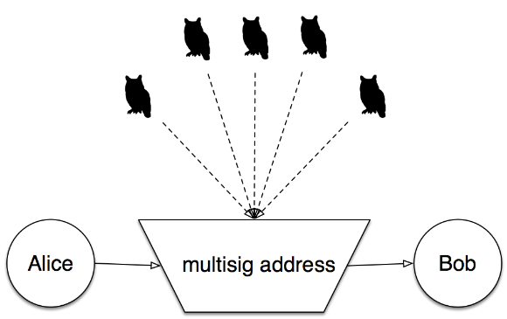


Pattern 2: Decentralized Oracle 3/3
Orisi on Bitcoin allows participants involved in a transaction to select a set of independent oracles
Related Patterns
Pattern 1. Centralized Oracle
Pattern 3. Voting
Pattern 4. Reverse Oracle
Known uses
Augur is a prediction market that use human oracles
Gnosis is a prediction market allows users to choose oracles they trust
Notes:
Orisi on Bitcoin maintains a set of independent oracles. Orisi allows the participants involved in a transaction to select a set of oracles and define the value of M before initiating a conditional transaction.
– Gnosis is a decentralized prediction market that allows users to choose any oracle they trust, such as another user or a web service, e.g. , for weather forecasts. A human oracle is also called arbitrator, who is trusted by the interacting participants to resolve disputes or check external state.
– Augur is another prediction market that leverages the capability of human oracles to do prediction and resolve disputes.

Slide 12
Student Task
Take 30 seconds to think about applying this pattern for any use case you know about
Maybe exam registration?
Then we’ll discuss

Slide 13
Pattern 3: Voting 1/3
Summary
Voting is a method for a group of blockchain users of a decentralized oracle to make a collective decision or to achieve a consensus
Context
Public access of blockchain provides equal rights
Participant has the same ability to access and manipulate the blockchain
Problem
Participants have different preference
Forces
Decentralization
Devolves responsibility and capability from a central location to all the participants
Consensus
Participants need to reach an agreement to make decision
Notes:
Context: The public access of blockchain provides equal rights that allow every participant the same ability to access and manipulate the blockchain.
This property of blockchain enables a new business model for organization, where everyone has equal right to participate in decision making.
Problem: Participants of a system have different preferences when making a decision.
Forces: The problem requires to balance the following forces: Decentralization . Decentralization devolves responsibility and capability from a central location or authority to all the participants of the system.
Consensus. The participants need to reach an agreement to make decision.

Slide 14
Pattern 3: Voting 2/3
Solution
Vote through sending transaction from blockchain account
Voting transaction is signed by the private key
Represent the right to make decision
Might be weighted by the owned resource
Can be set up to be anonymous, but is more difficult
Consequences
Benefits
Equality: Participants use their right to make decision
Consensus: participants with different preferences can reach consensus
Drawbacks
Collusion: Collude during voting to gain benefit
Permission grant: Pseudonomity may allow participant to gain additional voting power
Through owning multiple blockchain addresses, if that is the only requirement for participation
Time
Long voting/dispute time windows
Notes:
Solution: Voting method is used by a group of participants to make a collective decision or express an opinion.
To make a decision, every participant vote through sending transaction through her/his blockchain account.
The voting transaction is signed by the private key of the participant,
Represents the right of the participant to make decision. Such right can be weighted by the resource owned by the participant, like the stake.
Normally, majority rule is used to selects alternative, which has more than half of the votes.
Equality. Voting method allows the participants to use their right to participate decision making.
Consensus. Participants with different preferences can reach a consensus through voting.
Collusion. Participants might collude during voting to gain benefit.
Permission grant. Since blockchain is pseudonymous, every participant can own multiple blockchain addresses to gain additional voting power, which is similar to the Sybil attack at network layer.
Time. Voting may take a long time due to long voting/dispute time windows

Slide 15
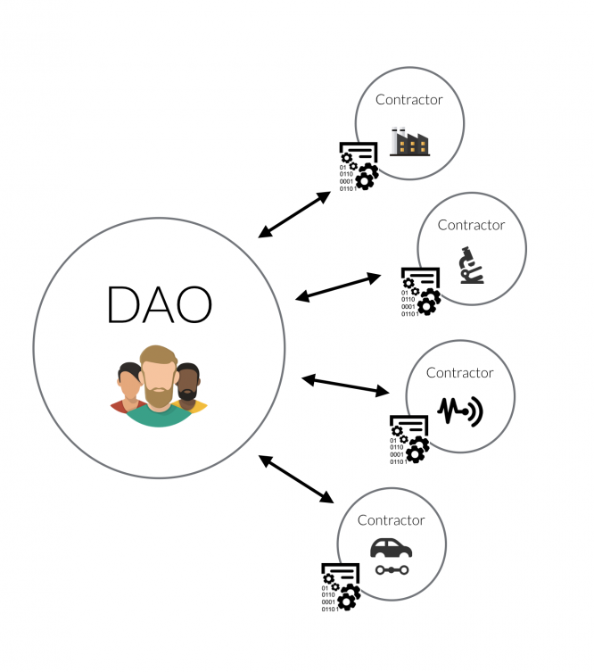
Pattern 3: Voting 3/3
Related Patterns
Pattern 2. Decentralized Oracle
Pattern 10. Multiple Authorization
Pattern 13. Security Deposit
Known uses
Voting is used in DAOs (Decentralized Autonomous Organizations)
Gnosis
Voting is used to challenge the reported outcomes
Augur
Similarly, voting is used to resolve dispute
Notes:
Voting mechanism is used in DAOs (Decentralised Autonomous Organisations)
In Gnosis prediction market, a voting mechanism is used if someone challenges the reported outcome. This voting mechanism allows users to vote on what the correct outcome was by betting Ether on that outcome.
In Augur prediction market, a similar voting mechanism is used to resolve disputes on the outcome reported by oracles.

Slide 16
Student Task
Take 30 seconds to think about applying this pattern for any use case you know about
Maybe exam registration?
Then we’ll discuss

Slide 17
Pattern 4: Reverse Oracle 1/3
Summary
The reverse oracle of an existing system relies on smart contracts to validate requested data and check required status
Context
Off-chain components might need to use the data stored on the blockchain
Off-chain components might need to the smart contracts to check certain conditions
Problem
Some domains use very large and mature systems, which comply with existing standards
Leverage the existing complex systems with blockchain without changing the core of the existing systems
Forces
Connectivity
Integrate blockchain to leverage the unique properties of blockchain
Simplicity
Introduce minimal changes to the existing system
Notes:
Context: In a software system, where blockchain is one of the components, the off-chain components might need to use the data stored on the blockchain
and the smart contracts running on the blockchain to check certain conditions.
Problem: Some domains use very large and mature (or even legacy) systems, which comply with existing standards.
For such domains, an non-intrusive approach is desired to leverage the existing complex systems with blockchain without changing the core of the existing systems. How to integrate the blockchain within existing systems?
Connectivity. Integrating blockchain into an existing system to leverage the unique properties of blockchain.
Simplicity. Introduce minimal changes to the existing system.

Slide 18
Pattern 4: Reverse Oracle 2/3
Solution
Transaction ID and Block ID can be integrated into existing system
Validation is on blockchain using smart contract
An off-chain component is required to query blockchain, which serves as store of current variable values
e.g., who is allowed physical access to a device
Consequences
Benefits
Connectivity:
Blockchain is integrated into a system through adding IDs of transaction as a piece of data into the system
Drawbacks
Non-intrusive
Writing and reading blockchain might need changes to the existing system
Notes:
Solution: The unique ID of the transactions or blocks on blockchain is a piece of data that can be easily integrated into the existing systems.
Validation of the data can be implemented by smart contracts running on blockchain.
An off-chain component is required to query the blockchain through using the ID of the data.
Connectivity. The blockchain is integrated into an existing system through adding the ID of the transaction as a piece of data into the system, and using smart contracts to do data validation.
Non-intrusive. It’s not always possible to use blockchain in a non-intrusive way depending on the extensibility of the existing systems.
Writing and reading blockchain might need changes to the existing system.

Slide 19


Pattern 4: Reverse Oracle 3/3
Related Patterns
Pattern 1. Centralized Oracle
Pattern 2. Decentralized Oracle
Known uses
Identitii
Enrich payment in banking systems with documents and attributes using blockchain
Identity token exchanged between the banks through SWIFT protocol
Slock.it
Autonomous objects and universal sharing network
Availability information is stored on blockchain
Validity checking is on blockchain
E.g., rent your neighbour‘s lawnmower
Notes:
Identitii provides a solution to enrich the payments in banking systems with documents and attributes through using blockchain.
Identitii invents the concept of identity token stored on a blockchain.
Every payment is associated with an identity token, which is used to exchange enriched information about a payment.
The identity token is exchanged between the banks through being embedded into the SWIFT protocol.
Slock.it is aimed to build autonomous objects and an universal sharing network through using blockchain and IoT devices
where the devices can sell or rent themselves, and also pay for services provided by others. In terms of renting a device, the availability information is stored on blockchain
validity checking can be done on blockchain.

Slide 20
Student Task
Take 30 seconds to think about applying this pattern for any use case you know about
Maybe exam registration?
Then we’ll discuss

Slide 21
Pattern 5: Legal and Smart Contract Pair 1/3
Summary
A bidirectional binding is established between a legal agreement and the corresponding smart contract
Context
Internationally, the legal industry is increasingly digitized
Digital signature is a valid way to sign legal agreements in many countries
Ricardian contract
Interpret legal contracts digitally without losing the value of the legal prose
An independent trustworthy execution platform is needed to execute the digital legal agreement
Problem
Bind a legal agreement to the corresponding smart contract to ensure 1-to-1 mapping
Forces
Authoritative source: 1-to-1 mapping makes SC the authoritative source of legal contract
Secure storage: Blockchain is a trustworthy data storage
Secure execution: Blockchain provides a trustworthy computational platform
Notes:
Context: The legal industry is becoming digitized, for example, using digital signatures has become a valid way to sign legal agreements.
The Ricardian contract was developed in the mid 1990s to interpret legal contracts digitally without losing the value of the legal prose.
Digital legal agreements need to be executed and enforced.
Problem: An independent trustworthy execution platform trusted by all the involved participants is needed to execute the digital legal agreement.
How to bind a legal agreement to the corresponding smart contract on a trusted execution environment to ensure a 1-to-1 mapping?
Forces:
Authoritative source. A 1-to-1 mapping is required between a legal contract and its corresponding smart contract to make the smart contract as the authoritative source of the legal contract.
Secure storage. Blockchain provides a trustworthy data storage to keep the legal agreement.
Secure execution. Blockchain also provides a trustworthy computational platform that can execute digital agreements to enforce certain conditions as defined in a legal contract.

Slide 22
Pattern 5: Legal and Smart Contract Pair 2/3
Solution
SC implements conditions defined in the legal agreement
Checked and enforced by the smart contract
SC has a blank variable to store hash of legal contract
SC address included in the legal agreement
Legal agreement hash is added to the SC variable, which is immutable after first write (e.g. “final”)
Sign legal contract only after variable is written
Consequences
Benefits
Automation: SCs are programs running on blockchain
Audit trail: immutable historical transactions enable auditing at anytime in future
Drawbacks
Expressiveness: Smart contract language might have limited expressiveness to express contractual terms
Enforceability: No central authority to decide a dispute or perform the enforcement of a court judgment
Interpretation: Ambiguity of natural language is a challenge to accurately digitize a certain legal term
Notes:
Solution: Blockchain can be an ideal trusted platform to run digital legal agreements, which are bound with corresponding on-chain smart contracts.
The smart contract implements conditions defined in the legal agreement.
When deployed, there is a variable to store the hash value of the legal agreement, but is initially a blank value.
The address of the smart contract is included in the legal agreement,
and then the hash of the legal agreement is calculated and added to the contract variable.
By binding a physical agreement with a smart contract, the bridge between the off-chain physical agreement and the on-chain smart contract is established.
The two directional binding makes sure that the legal agreement and smart contract have a 1-to-1 mapping.
The smart contract digitizes the conditions defined within the legal agreement. Thus, these conditions can be checked and enforced automatically by the smart contract.
However, not all the legal terms can be easily digitalized.
The smart contract can also enable automated regulatory compliance checking in terms of the required information and process.
However, the capability of compliance checking might be limited due to the constraints of smart contract programming language.
Automation. Some of the conditions defined in the legal contract, for example, a conditional payment, can be automatically enforced by blockchain.
Audit trail. Blockchain permanently records all historical transactions related to the legal contract and the contract itself.
This immutable data enables auditing at anytime in future.
Expressiveness. Smart contracts are written in programming languages.
The smart contract languages might have limited expressiveness to express contractual terms of arbitrary complexity.
The capability of regulatory compliance checking also depends on the expressiveness of the smart contracts.
A regulation may regulate the process, for example, what should or should not be done by whom at what stage.
Enforceability. If a public blockchain is used, there is no central administering authority to decide a dispute, or perform the enforcement of a court judgment.
Interpretation. There might be different ways to interpret a certain legal term and to encode them in the smart contract.
Ambiguity of natural language makes it a challenge to accurately implement a certain legal term in a way that is agreed upon by all the involved participants.

Slide 23
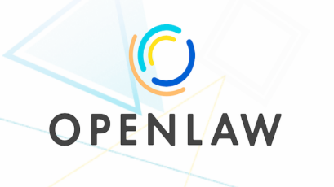


Pattern 5: Legal and Smart Contract Pair 3/3
Related Patterns N/A
Known uses
OpenLaw
Legally binding and self- executable agreements on the Ethereum blockchain
The legal agreement templates are stored on a decentralized data storage, IPFS
Smart Contract Template proposed by Barclays uses legal document templates to facilitate smart contracts running on Corda
Accord Project explored the representation of machine-interpretable legal terms
Notes:
OpenLaw is a platform that allows lawyers to make legally binding and self- executable agreements on the Ethereum blockchain.
The legal agreement templates are stored on a decentralized data storage, IPFS. Users can create customized contracts for specific uses.
Smart Contract Template proposed by Barclays uses legal document templates to facilitate smart contracts running on Corda blockchain plat- form.
Specific proposals for the representation of machine-interpretable legal terms have been explored in KWM’s project on digital and analog (DnA) contracts and in the Accord Project.

Slide 24
Student Task
Take 30 seconds to think about applying this pattern for any use case you know about
Maybe exam registration?
Then we’ll discuss

Slide 25
Related Patterns
Pattern 1. Centralized Oracle
Decentralize
Pattern 2. Decentralized Oracle
Reverse
Reach Consensus
Pattern 4.
Reverse Oracle
Pattern 3.
Voting
Support
Support
Pattern 5.
Legal and Smart Contract Pair
Pattern 10.
Multiple Authorization
Pattern 13.
Security Deposit
Notes:
Pattern 2 decentralized oracle distribute pattern 1 centralized oracle.
Pattern 3 voting is used to reach consensus in decentralized oracle
Pattern 10 and pattern 13 can be used to implement voting pattern. Multiple signature is used to cast vote, and security deposit is used to secure the voting process
Centralized oracle and decentralized oracle inject state from external world to blockchain, while reverse oracle use the data stored on blockchain in existing systems.

Slide 26
Blockchain-based Application Pattern Collection: Data Management

Slide 27
Pattern Collection (Chapter 7)
Interaction with External World
Centralized Oracle
Decentralized Oracle
Data Management
Encrypting On-chain Data
Voting
Tokenisation
Security
Multiple Authorization
X-confirmation
Security Deposit
Contract Structural Patterns
Contract Registry
Embedded Permission
Data Contract
Factory Contract
Incentive Execution
Deployment
Semi-dapp
dapp
Legal and Smart Contract Pair
Reverse Oracle
Off-chain Data Storage
State Channel
Dynamic Authorization
Mixed on and off-chain
Purely on-chain
Notes:
Overview of pattern collections in five categories, including
On-chain and off-chain is the fundamental design decision
Oracles are offchain, legal and smart contract pair on chain
One by one discuss

Slide 28
Pattern 6: Encrypting On-chain Data 1/3
Summary
Ensure confidentiality of the data stored on blockchain by encrypting it
Context
Critical data that is only accessible to the involved participants
E.g.: special discount price offered by a service provider to a subset of its users
Problem
Data privacy is a limitation of blockchain
All information on blockchain is publicly available to all participants
No privileged user
Forces
Transparency
Historical transactions are publically accessible to enable validation of previous transactions
Lack of confidentiality
Commercially sensitive data should not be stored on blockchain
Notes:
Context: For some applications on blockchain, there might be commercially critical data that should be only accessible to the involved participants.
An example would be a special discount price offered by a service provider to a subset of its users.
Such information should not be accessible to the other users who do not get the discount.
Problem: The lack of data privacy is one of the main limitations of blockchain.
All the information on blockchain is publicly available to the participants of the blockchain.
There is no privileged user within the blockchain network, no matter the blockchain is public, consortium or private.
On a public blockchain, new participants can join the blockchain network freely and access all the information recorded on blockchain.
Any confidential data on public blockchain is exposed to the public.
Transparency .Every participant within a blockchain network is able to access all the historical transactions on blockchain
enable them to validate previous transactions.
The transactions on a public blockchain are also accessible to everyone with access to the internet, simply using tools like a blockchain explorer such as Etherscan.
Lack of confidentiality. Since all the information on blockchain is publicly available to everyone in the network, commercially sensitive data meant to be kept confidential should not be stored on blockchain, at least not in plain form.

Slide 29
Pattern 6: Encrypting On-chain Data 2/3
Solution
Data is encrypted before being inserted into blockchain
Symmetric encryption, or
Asymmetric encryption
Consequences
Benefits
Confidentiality： Encrypted data is useless to anyone without the secret key
Drawback
Compromised key： Encryption mechanism does not guarantee the confidentiality or integrity with a compromised or disclosed key
Access revocation： Access of encrypted data exists ‘forever’ because of immutability
Immutable data： Subject to brute force decryption attack
Quantum computing
Key sharing： Off-chain key exchange, otherwise accessible to all blockchain participants
Notes:
Solution: To preserve the privacy of the involved participants, symmetric or asymmetric encryption can be used to encrypt data before inserting the data into blockchain.
One possible design for sharing encrypted data among multiple participants is as follows. First, one of the involved participants creates a secret key for encrypting data and distributes it during an initial key exchange. When one of the participants needs to add a new data item to the blockchain, they first symmetrically encrypt it using the secret key. Only the participants allowed to access the transaction have the secret key and can decrypt the information.
Confidentiality. Using encryption, the publicly accessible information on blockchain is encrypted, so that is useless to anyone who does not hold the secret key.
Compromised key. Both symmetric and asymmetric encryption require off-chain key management.
If key management is not done properly, it can lead to compromise and disclosure of private or secret keys.
If the required private key or secret key is compromised,
the encryption mechanism does not guarantee the confidentiality nor the integrity of the data.
Access revocation. Revoking read access is a challenge after the encrypted data has been published to the blockchain.
The encrypted data on blockchain is immutable.
as long as the participant keeps the secret key used to encrypt the data
it has access to the encrypted data forever.
Immutable data. Even if stored in encrypted form, the critical data will remain in the blockchain forever.
In addition to the risk of key compromise, the encrypted data may be subject to brute force decryption attacks at any time in the future
breakthroughs in technology like quantum computing might render current encryption technologies ineffective.
So even if the data is considered to be secure with a given key size when it is stored in the blockchain, this may no longer be the case in the future.
Key sharing. The encryption key needs to be shared off-chain before submitting any relevant transaction to the blockchain secretly.
Although blockchain can be used as a software connector to communicate data, secret keys can not be shared through blockchain
because the shared key would be publicly accessible if being communicated through blockchain.

Slide 30
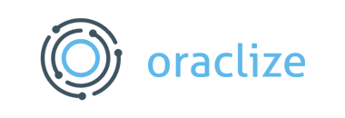
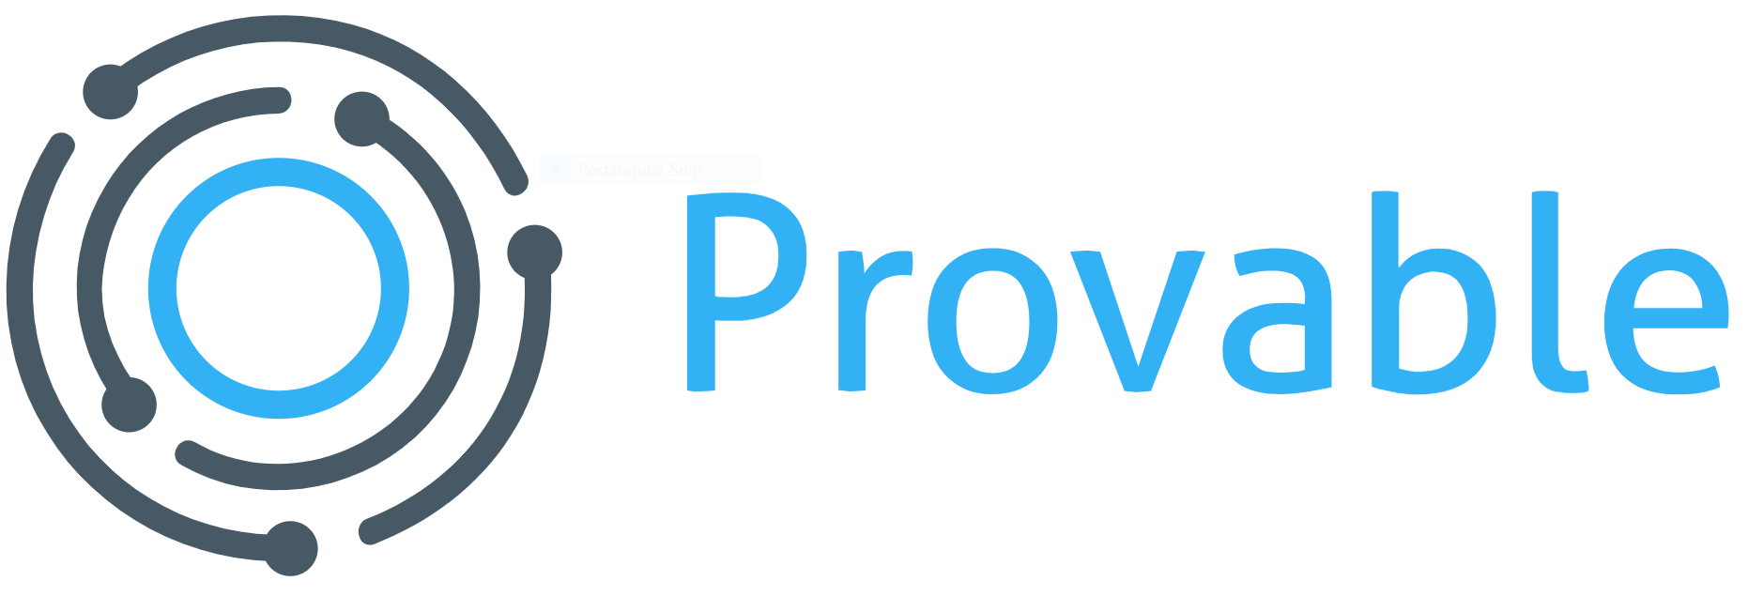
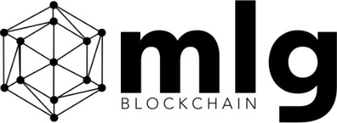
Pattern 6: Encrypting On-chain Data 3/3
Related Patterns
Pattern 8. Off-Chain Data Storage
Known uses
Encrypted queries from Oraclize / Provable (new name)
Developers can encrypt the parameters of their queries before passing them to a smart contract
Crypto digital signature from MLGBlockchain
Encrypting data before sharing it between the parties
Hawk* stores transactions as encrypted data on blockchain to retain the privacy of the transactions
Automatically generate a cryptographic protocol for a smart contract
Involved participants interact with the blockchain following the cryptographic protocol
*Kosba, A., Miller, A., Shi, E., Wen, Z., Papamanthou, C.: Hawk: The blockchain model of cryptography and privacy-preserving smart contracts. In: IEEE Symposium on Security and Privacy (S&P2016)
Notes:
Encrypted queries from Oraclize.
As mentioned earlier, Oraclize is a smart contract running on Ethereum public blockchain, which provides a service to access state from external world.
Oraclize allows smart contract developers to encrypt the parameters of their queries locally by using a public key before passing them to a smart contract.
The only one who can decrypt the call parameters is Oraclize with the paired private key.
Crypto digital signature suggested by MLGBlockchain
encrypt data and share the data between the parties who interact and transmit data through blockchain.
Hawk is a smart contract system that stores transactions as encrypted data on blockchain to retain the privacy of the transactions.
The compiler of Hawk can automatically generate a cryptographic protocol for a smart contract.
The involved participants interact with the blockchain following the cryptographic protocol.

Slide 31
Student Task
Take 30 seconds to think about applying this pattern for any use case you know about
Maybe exam registration?
Then we’ll discuss

Slide 32
Pattern 7: Tokenization 1/3
Summary
Using tokens to represent transferrable goods for easier handling
Context
Reduce risk in handling high-value assets by replacing them with equivalents
Similar to tokens used in casinos
Tokens represent transferable goods or rights
Shares or tickets
Problem
Tokens representing assets should be transferrable
One authoritative source of ownership of corresponding assets, needs to be queryable
Forces
Risk
Handling fungible financial instruments with high value is risky
Authority
Tokens are the authoritative source of the assets
Notes:
Context: The concept of tokenisation has emerged centuries ago with the first currency systems.
Tokenisation is a means to reduce risk in handling high value financial instruments by replacing them with equivalents,
for example, the tokens used in casino.
Tokens can represent a wide range of goods which are transferable and fungible, like shares, or tickets.
Problem: Tokens representing assets should be the authoritative source of the corresponding assets.
Forces: The problem requires to balance the following forces:
Risk. Handling fungible financial instruments with high value is risky, e.g., lost tokens cannot be replaced.
– Authority. Tokens should be the authoritative source of the assets.

Slide 33


Pattern 7: Tokenization 2/3
Solution
Native tokens on blockchain can also be used to represent other digital or physical assets
Transactions record the verifiable title transfer from one user to another
With limited condition checking
Smart contract-based data structure used to represent physical assets
On-chain token is the authoritative source of the (physical) asset
Consequences
Benefits
Risk: Replacing high-value financial instruments with equivalents
Authority and single source of truth
Drawbacks
Integrity: Authenticity of a physical asset is not guaranteed automatically
Legal process for ownership:
Owner of an asset may be entitled to sell the asset without being required to create a transaction on the blockchain
represented
Asset
lock
Custody
Notes:
Blockchain provides a trustworthy platform to realise tokenisation.
There are different ways to implement tokenisation using blockchain. Naive tokens on a blockchain can be used to formulate a system where the tokens represent monetary value or other physical assets.
The token is generally used to track title over the physical assets.
Transactions on blockchain record the verifiable title transfer from one user to another.
Using the native token on blockchain for tokenisation is limited because it can only implement the title transfer of the physical assets, with limited conditions checking.
A more flexible way is to define a data structure in a smart contract to represent physical assets.
Tokenisation is a process starting from an asset (e.g., money) is locked under a custody (e.g., a bank),
and gets represented in the cryptographic world through a token.
The ownership of the digital token matches the ownership of the corresponding asset. The reverse process can take place by which the user redeems the token to recover the value which is sitting within the bank.
A token on blockchain is the authoritative source of the physical asset. By using smart contracts, some conditions can be implemented and associated with the ownership transfer.
Risk. Tokenisation reduces risk in handling high value financial instruments by replacing them with equivalents.
Authority. Blockchain and smart contracts provide a trustworthy infrastructure to provide authorised tokens for the corresponding assets.
Integrity. Integrity of the tokens is guaranteed by the blockchain infrastructure. But the authenticity of the corresponding physical/digital asset is not guaranteed automatically.
Legal processes for ownership. A token on a blockchain is not necessarily the authoritative source of information about the ownership of a physical asset. The owner of an asset may be entitled to sell the asset without being required to create a transaction on the blockchain.
Also, legal processes such as court orders and bankruptcy proceedings can change the ownership of physical assets without any associated transaction being recorded on the blockchain.

Slide 34
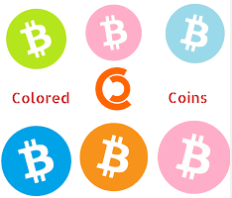
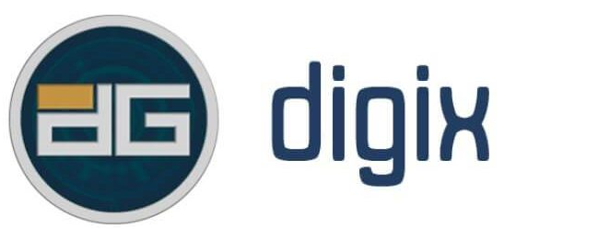
Pattern 7: Tokenization 3/3
Related Patterns N/A
Known uses
Coloredcoin
Open source protocol for tokenizing digital assets on Bitcoin blockchain
Digix
Use tokens to track the ownership of gold as a physical asset(s)
Notes:
Coloredcoin is an open source protocol for tokenizing digital assets on Bitcoin blockchain.
Digix uses tokens to track the ownership of gold as a physical property.

Slide 35
Student Task
Take 30 seconds to think about applying this pattern for any use case you know about
Maybe exam registration?
Then we’ll discuss

Slide 36
Pattern 8: Off-chain Data Storage 1/3
Summary
Using hashing to ensure the integrity of arbitrarily large data
Context
Using blockchain to secure data integrity
Problem
Limited storage capacity: full replication across all participants of the blockchain network
Limited size of the block: Storing large amounts of data within a transaction is impossible
Block gas limit in Ethereum; direct limitations in Bitcoin
Data cannot take advantage of immutability or integrity guarantees off-chain
Forces
Scalability: data is replicated permanently across all nodes
Cost: Public blockchain charges real money: One-time cost
Size: Limits of transaction size or block size
Bitcoin relays OP_RETURN transactions up to 40 bytes
Notes:
Context: Some applications consider using the blockchain to guarantee the integrity of large amounts of data.
Problem: The blockchain, due to its full replication across all participants of the blockchain network, has limited storage capacity.
Storing large amounts of data within a transaction may be impossible due to the limited size of the blocks of the blockchain
(for example, Ethereum has a block gas limit to determine the number, computational complexity, and data size of the transactions included in the block).
Data cannot take advantage of the immutability or integrity guarantees without being stored on the blockchain.
How to store data of arbitrary size and take advantage of the immutability and integrity guarantees provided by the blockchain?
Scalability. Blockchain provides limited scalability because every bit of data is replicated across all nodes, where it is kept permanently.
Cost. If a public blockchain is used, storing data on blockchain costs real money, although the cost is a one-time cost to write the data.
This is in contrast to traditional distributed data storage, like cloud, which charge based on the amount of allocated storage space over time.
Size. There are limits of transaction size or block size.
on Bitcoin blockchain, The default Bitcoin client only relayed OP_RETURN transactions up to 80 bytes, which was reduced to 40 bytes in February 201433.

Slide 37
Pattern 8: Off-chain Data Storage 2/3
Solution
Data of big size
Data that is bigger than its hash value
Hash value of the data is stored on blockchain
Maybe with other small metadata: URI to data location
Consequences
Benefits
Integrity:
Blockchain guarantees integrity of the hash value
Hash value guarantees integrity of the raw data
Cost: Fixed low cost for integrity of large(r) data
Drawbacks
Integrity
Raw data might be changed without authorization
Detectable but irrecoverable
Data loss: Off-chain raw data may be deleted or lost
Notes:
Solution: The blockchain can be used as a general-purpose replicated database, as transactions logged in the blockchain can include arbitrary data on some blockchain platforms.
For data of big size (essentially data that is bigger than its hash value), rather than storing the raw data directly on blockchain, a representation of the data with smaller size can be stored on blockchain with other small sized metadata about the data (e.g., a URI pointing to it).
The solution is to store a hash value (also called digest) of the raw data on chain. The value is generated by a hash function, e.g. one from the SHA-2 [6] family, which maps data of arbitrary size to data of fixed size.
Hash function is a one-way function which is easy to compute, but hard to invert given the output of a random input.
If even one bit of the data changes, its corresponding hash value would change as well.
Integrity. Blockchain guarantees the integrity of the hash value that represents the raw data. The integrity of the raw data can be checked using the on-chain hash value.
Cost. If a public blockchain is used, blockchain is utilized at a lower cost (fixed cost as the size of the hash value is fixed) for integrity of data with arbitrary size.
Integrity. The raw data is stored off-chain, where the off-chain data store might not be as secure as blockchain.
The raw data may be changed without authorization.
This change will be detected thanks to the hash of the original data stored on the blockchain.
Without additional measures, it will neither be possible to recover the original data nor to prevent the change from happening in the first place.
Data loss. Since the raw data is stored off-chain, it may be deleted or lost. Only its hash value remains permanently on the blockchain.

Slide 38


Pattern 8: Off-chain Data Storage 3/3
Related Patterns
Pattern 9. State Channel
Known uses
Proof-of-Existence (POEX.IO).
Entering an SHA-256 cryptographic hash of a document into the Bitcoin blockchain
A “proof- of-existence” of the document at a certain time.
Chainy
Smart contract running on Ethereum blockchain
Stores a short link to an off-chain file and its corresponding hash value in one place.
Notes:
Proof-of-Existence (POEX.IO). This service allows entering an SHA-256 cryptographic hash of a document into the Bitcoin blockchain as a “proof- of-existence” of the document at a certain time.
The hash value guarantees the data integrity of the document.
Chainy. This is a smart contract running on Ethereum blockchain.
Chainy stores a short link to an off-chain file and its corresponding hash value in one place.

Slide 39
Student Task
Take 30 seconds to think about applying this pattern for any use case you know about
Maybe exam registration?
Then we’ll discuss

Slide 40
Pattern 9: State Channel 1/3
Summary
Micro-payments exchanged off-chain and periodically recording settlements for larger amounts on chain
Can be generalized for arbitrary state updates
Context
Micro-payments are payments that can be as small as a few cents
E.g., payment of a very small amount of money to a WiFi hot-spot for every 10 kilobytes of data usage
Problem
Decentralized design has limited performance: Long commit time
High transaction fees on a public blockchain: Largely independent of the transacted amount
Forces
Latency
Long commitment time on blockchain
Micro-payment is expected to happen instantaneously
Scalability: data replicated permanently across all nodes
Cost： Transaction fee might be higher than the monetary value associated with micro-payment transaction
Notes:
Summary: Micro-payments transactions are too expensive to be performed on- chain because the required transaction fee might be higher than the monetary value associated with the transaction assuming a public blockchain is used.
Thus, micro-payments should be exchanged off-chain while periodically recording settlements for larger amounts on chain.
Such a payment channel can be generalized for arbitrary state updates for more general purposes other than monetary value.
Context: Micro-payments are payments that can be as small as a few cents, e.g., payment of a very small amount of money to a WiFi hot-spot for every 10 kilobytes of data usage.
Blockchain has potential to be used for such financial transactions with tiny monetary value. The question is if it is necessary and cost effective to store all the micro-payment transactions on blockchain.
Problem: The decentralized design of blockchain has limited performance. Transactions can take several minutes or even one hour (for Bitcoin blockchain) to be committed on the blockchain.
Due to the long commit time and high transaction fees on a public blockchain (where fees are largely independent of the transacted amount),
it is often infeasible to store every micro-payment transaction on the blockchain network.
During a recent peak in demand, the average fee per transaction has risen to the equivalent of US$5536 on Bitcoin. On-chain transactions are suitable for transactions with medium to large monetary value, relative to the transaction fee.
Latency. Blockchain transactions may take a long time to be committed while users expect micro-payments to happen instantaneously.
Scalability. Blockchain has limited scalability because every bit of data is replicated across all nodes, and kept permanently.
Cost. Storing data on a public blockchain costs real money. The transaction fee of individual micro-payment transaction might be higher than the monetary value associated with the micro-payment transaction.

Slide 41
Pattern 9: State Channel 2/3
Solution
Establish a payment channel between two participants
Deposit from one or both sides looked up
Payment channel keeps the intermediate states
Only the finalized payment is on chain
Frequency of settlement depends on use cases
Consequences
Benefits
Speed: off-chain transaction settled without waiting for blockchain network to process the transaction
Throughput: off-chain transaction throughput is not limited by blockchain configuration
Privacy: the intermediate off-chain transactions do not show up in the public ledger
Cost: only the final settlement transaction costs fee to be stored on blockchain
Drawbacks
Trustworthiness: Micro-payment transactions are not immutable and can be lost after the channel is closed
Reduced liquidity: Locked up security deposit reduces liquidity of channel participants
Notes:
Solution: Storing every micro-payment transaction on blockchain is infeasible in certain contexts due to the small monetary value associated with it.
Thus, a solution is to establish a payment channel between two participants,
with a deposit from one or both sides of the participants locked up as security in a smart contract for the lifetime of the payment channel.
The payment channel keeps the intermediate states of the micro-payment off-chain, and only stores the finalized payment on chain.
The frequency of transaction settlement depends on the use case, and agreement between the two sides.
For example, in scenarios around utilities, internet service providers or electricity companies can establish payment channel with their consumers for an agreed billing period, for example, a month.
As the consumer uses data or energy daily, the intermediate state is stored in the channel until the end of the month, when the channel is closed to finalize the payment of that month.
Speed. Without involving blockchain for every transfer, the off-chain transactions can be settled without waiting for the blockchain network to process the transaction, generate a new block with the transaction and reach consensus, and the desired number of confirmation blocks.
Throughput. The number of off-chain transactions that can be processed is not limited by the configuration of blockchain, such as the block size, block interval, gas limit, etc.,
and thus a much higher throughput can be achieved than for on-chain transactions.
Privacy. Other than the final settlement transaction, the individual off-chain transactions do not show up in the public ledger, thus, the detail of these intermediate off-chain transactions is not publicly visible.
Cost. If a public blockchain is used, only the final settlement transaction costs transaction fee to be included in the blockchain. Direct individual off- chain transactions do not cost any money.
Trustworthiness. The individual off-chain micro-payment transactions might not be as trustworthy as the on-chain transactions because the micro-payment transactions are not stored in an immutable data store.
The intermediate state of payment channels might be lost after the payment channels are closed.
Reduced liquidity. To establish a payment channel, money from one or both sides of the channel needs to be locked up in a smart contract for the lifetime of the payment channel.
The liquidity of the channel participants is thereby reduced.
Wallet. A new wallet or extension to the existing wallet is needed to support the micro-payment protocol.

Slide 42


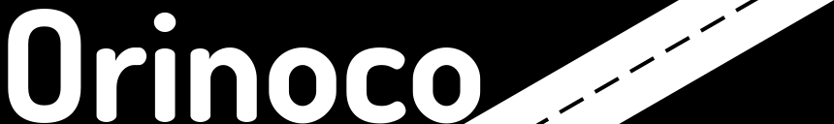
Pattern 9: State Channel 3/3
Related Patterns
Pattern 8. Off-Chain Data Storage
Known uses
Raiden network on Ethereum
Hashed Timelock Contracts (HTLCs)
Hashlocks and timelocks of Script
Bi-directional payment channel
Orinoco on Ethereum is a payment hub for payment channel management
Notes:
A network of micro-payment channels can be built where the transactions transferring small values occur off-chain.
The individual transactions take place entirely off the blockchain and exclusively between the participants, across multiple hops where needed.
Only the final transaction that settles the payment for a given channel or set of channels is submitted to the blockchain.
The technologies used to implement state channel are specific to blockchain platform.
For example, Lightning network on the Bitcoin blockchain is a proposed implementation of Hashed Timelock Contracts (HTLCs) with bi-directional payment channels which allows secure payments across multiple peer-to-peer channels.
A HTLC is a type of payments that use the features of Script, like hashlocks and timelocks, to require that the receiver of a payment acknowledges receiving the payment prior to a deadline by generating cryptographic proof.
The Lightning network uses an off-chain protocol to enable micro-payments of Bitcoin and several other crypto-currencies. Micro-payments are enabled by establishing a bidirectional payment channel through committing a funding transaction to the blockchain.
This can be followed by a number of micro-payment transactions that update the distribution of the funds within the channel without broadcasting transactions to the blockchain network. The payment channel can be closed by broadcasting the final version of the fund- ing transaction to settle the payment.
The Raiden network on the Ethereum blockchain is a similar solution as lightning network.
The basic idea is to avoid the consensus bottleneck by leveraging a network of off-chain payment channels that allow to securely transfer monetary value.
Smart contracts are used to deposit value into the payment channels.
Orinoco is another payment channel solution built on Ethereum blockchain.
Other than the payment channels, Orinoco also provides a payment hub for payment channel management. However, the payment hub introduces an extra party that needs to be trusted by both the sender and the recipient of the payment channel.
State channel on Ethereum and Gnosis Go offer a more generalized form of state channels that support exchanging state for general-purpose applications.

Slide 43
Student Task
Take 30 seconds to think about applying this pattern for any use case you know about
Maybe exam registration?
Then we’ll discuss

Slide 44
Related Patterns
Pattern 6.
Encrypting
On-chain Data
Work with
Pattern 8.
Off-chain Storage
Special data storage
for micro-payment
Work with
Pattern 7.
Tokenisation
Pattern 9.
State Channel
Notes:
In a blockchain-based system, pattern 6 and pattern 8 might work together.
On chain data is encrypted to preserve privacy. And non-critical data is stored off-chain.
State channel is a special data storage
tokenization can also works with pattern 8 if the asset being represented is a digital asset storing in a off-chain storage.

Slide 45
Blockchain-based Application Pattern Collection: Security

Slide 46
Pattern Collection (Chapter 7)
Interaction with External World
Centralized Oracle
Decentralized Oracle
Data Management
Encrypting On-chain Data
Voting
Tokenisation
Security
Multiple Authorization
X-confirmation
Security Deposit
Contract Structural Patterns
Contract Registry
Embedded Permission
Data Contract
Factory Contract
Incentive Execution
Deployment
Semi-dapp
dapp
Legal and Smart Contract Pair
Reverse Oracle
Off-chain Data Storage
State Channel
Dynamic Authorization
Mixed on and off-chain
Purely on-chain
Notes:
Overview of pattern collections in five categories, including
On-chain and off-chain is the fundamental design decision
Oracles are offchain, legal and smart contract pair on chain
One by one discuss

Slide 47
Pattern 10: Multiple Authorization 1/3
Summary
A set of blockchain addresses which can authorize a transaction is pre-defined
Only a subset of the addresses is required to authorize transactions
Context
Activities might need to be authorized by multiple blockchain addresses
A monetary transaction may require authorization from multiple participants
Problem
The actual addresses that authorize an activity might not be able to be decided due to availability
May need to implement threshold voting, e.g., for board of directors
Forces
Flexibility
The actual authorities can be from a set of pre-defined authorities
Tolerance of compromised or lost private key
Blockchain does not offer any mechanism to recover a lost or a compromised private key
Losing a key results in permanent loss of control over an account and smart contracts
Notes:
Context: In blockchain-based applications, activities might need to be authorized by multiple blockchain addresses. For example, a monetary transaction may require authorization from multiple blockchain addresses.
Problem: The actual addresses that authorize an activity might not be able to be decided due to the availability of the authorities.
Flexibility. The actual authorities who authorize the transaction can be from a set of pre-defined authorities.
Tolerance of compromised or lost private key
Authentication on blockchain uses digital signature.
However, blockchain does not offer any mechanism to recover a lost or a compromised private key.
Losing a key results in permanent loss of control over an account, and potentially smart contracts that refer to it.

Slide 48
Pattern 10: Multiple Authorization 2/3
Solution
Concrete set of blockchain addresses for authorization is not decided before a transaction is submitted to blockchain
Multi-signature mechanism (M-out-of-N) is used to require more than one address to authorize a transaction
Consequences
Benefits
Flexibility: Enable flexible binding of authorities
Lost key tolerance
Owning multiple addresses to reduce the risk of losing control due to key loss
Threshold-based authorized update
Drawbacks
Pre-defined authorities: All the possible authorities need to be known in advance
Lost key: At least M among N private keys should be safely kept to avoid losing control
Cost of dynamism: Extra logic and extra addresses cost extra money
does deploying the logic for multiple authorities
Notes:
Solution: It would enable more dynamism if the set of blockchain addresses for authorization are not decided before the corresponding transaction being submitted into the blockchain network,
or the corresponding smart contract being deployed on blockchain.
On the Bitcoin blockchain, a multi-signature mechanism can be used to require more than one private key to authorize a Bitcoin transaction.
In Ethereum, smart contract can mimic multi-signature mechanism. More flexibly, an M-of-N multi-signature can be used to define that M out of N private keys are required to authorize the transaction.
M is the threshold of authorization. This on-chain mechanism enables more flexible binding of authorities.
Flexibility. This pattern enables flexible binding of authorities, but depends on the availability of authorities when the activity is proceeded.
Lost key tolerant. One participant can own more than one blockchain address to reduce the risk of losing control over their smart contracts due to a lost private key.
There could be a function that can update the list of allowed authorities, and the threshold of the authorization.
In the case that the update function also requires threshold-based authorization, the list of the update addresses can be also updated through authorization from at least the minimum number of addresses.
Pre-defined authorities. Although the pattern enables flexible binding, all the possible authorities still need to be known in advance of any decision or update.
Lost key. At least M private keys among the N private keys should be safely kept to avoid losing control.
Cost of dynamism. If a public blockchain is used, updating the list of authorities costs money, as does deploying the logic for multiple authorities. Besides, it costs more to store multiple addresses as the possible authorities than storing only one.

Slide 49
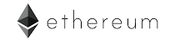
Pattern 10: Multiple Authorization 3/3
Related Patterns
Pattern 3. Voting
Pattern 11. Off-Chain Secret Enabled Dynamic Authorization
Known uses
Multi-signature mechanism provided by Bitcoin
Multi-signature wallet, written in Solidity, running on Ethereum blockchain
Available in the Ethereum dapp browser Mist
Notes:
MultiSignature mechanism provided by Bitcoin.
Multisignature wallet, written in Solidity, running on Ethereum blochchain and is available in the Ethereum DApp browser Mist.

Slide 50
Student Task
Take 30 seconds to think about applying this pattern for any use case you know about
Maybe exam registration?
Then we’ll discuss

Slide 51
Pattern 11: Dynamic Authorization 1/3
Summary
Using a hash created off-chain to dynamically bind authority for a transaction
Hashlock
Context
Activities might need to be authorized by unknown blockchain addresses
These participants are unknown when a first transaction in submitted to blockchain
Problem
The authority who can authorize a given activity is unknown
No dynamic binding with an address of a participant
All authorities for a second transaction are required to be defined in the first transaction
Forces
Dynamism: Dynamic binding multiple unknown authorities
Pre-defined authorities: all the possible authorities are required to be defined beforehand if on-chain mechanism is used
Notes:
Summary: This solution is also referred to as Hashlock.
Context: In blockchain-based applications, some activities need to be authorized by one or more participants that are unknown when a first transaction is submitted to blockchain.
Problem: Sometimes, the authority who can authorize a given activity is unknown when the corresponding smart contract is deployed, or the corresponding transaction is submitted to the blockchain.
Blockchain uses digital signature for authentication and transaction authorization.
Blockchain does not support dynamic binding with an address of a participant which is not defined in the respective transaction or smart contract.
All accounts that can authorize a second transaction have to be defined in the first transaction before that transaction is added to the blockchain.
The problem requires to balance the following forces:
Dynamism. Dynamic binding one or more unknown authorities with a second transaction representing an activity after the first transaction submitted to blockchain.
– Pre-defined authorities. Using only on-chain mechanisms, all the possible authorities are required to be defined beforehand.

Slide 52
Pattern 11: Dynamic Authorization 2/3
Solution
Transaction is “locked” by hash of an off-chain secret
Whoever receives the secret off-chain can authorize the Tx
Consequences
Benefits
Dynamism: Enable dynamic binding of unknown authorities
Lost key tolerance: No specific key is required to authorize Tx
Routability: Enable multi-hop transfer (e.g. in channels) with all payment Txs secured using the same secret → can open at same time
Interoperability: Enable interaction between other systems and blockchain
Drawbacks
One-off secret: Secret is not reusable after being revealed
Lost secret: Transaction is “locked” forever if the secret is lost
May allow “front-running” attacks: observe Tx with secret, try to use secret before original Tx
Combination of signature and secret
A large set of authorities are known, but not all of them are allowed to authorize transactions
Notes:
Solution: An off-chain secret can be used to enable a dynamic authorization when the participant authorizing a transaction is unknown beforehand.
In the context of payment, for example, a smart contract can be used as an escrow.
When the sender deposits the money to an escrow smart contract, a hash of a secret (e.g. a random string, called pre-image) is submitted with the money as well.
Whoever receives the secret off-chain can claim the money from the escrow smart contract by revealing the secret.
With this solution, the receiver of the money does not need to be defined beforehand in the escrow contract.
This can be generalized to any transaction that needs authorization from a dynamically bound participant.
Note that since the secret is revealed, it cannot be reused. One variant is to lock multiple transactions with the same secret – by unlocking one, all of them are unlocked.
Dynamism. This pattern enables dynamic binding of unknown authorities after the transaction is added into the blockchain.
Lost key tolerant. No specific private key is required to authorize transactions.
Routability. This pattern has the useful property that once the secret is revealed, any other transactions secured using the same secret can also be opened.
This makes it possible to create multiple transactions that are all locked by the same secret. This property is used by micro-payment channels to enable multi-hop transfers where the money hosted by every hop and secured by a same secret can be released after the end receiver claims the money with the secret (i.e. the secret is revealed).
The secret can be exchanged through an off-chain channel to every hop.
Interoperability. There is no need for a special protocol to exchange the secret. The secret can be exchanged in any ways off-chain. It provides a mechanism for other systems to trigger events on blockchain.
One-off secret. The secret used in this pattern is a one-off secret. Verification of the secret is on-chain. Thus, once a secret is embedded in a transaction submitted to the blockchain, the secret is revealed.
Lost secret. The sender/initiator of a transaction takes the risk of losing the off-chain secret. If the secret is lost, the transaction cannot be authorized and being proceeded anymore. In the case of money transfer, the money associated with the transaction would be locked forever if the transaction cannot be authorized properly.
Combination of signature and secret. Because this pattern has the property that once the secret is revealed, any other transactions secured using the same secret can also be opened,
sometimes the transaction protected by the secret should also be associated with a public key so that both a correct secret and an appropriate signature with the respective private key are required to authorize the transaction.
This is applicable to the situation where a large set of authorities are known beforehand, but not all of them are allowed to authorize a certain activity/transaction.
Thus, a hash secret is used to dynamically bind one or multiple authorities from the larger pre-defined set of authorities.

Slide 53
Pattern 11: Dynamic Authorization 3/3
Related Patterns
Pattern 10. Multiple Authorization
Known uses
Raiden network
Multi-hop transfer mechanism
hashlocked transactions securely router payment through a middleman
Atomic cross-chain trading in the Bitcoin ecosystem
Trading Bitcoin for tokens on a Bitcoin sidechain
Notes:
Raiden network enables secure value transfer. The multi-hop transfer mechanism in Raiden Network uses hashlocked transactions to securely router payment through a middleman.
In the Bitcoin ecosystem, atomic cross-chain trading allows one crytocurrency (for example, Bitcoin) to be traded for another cryptocurrency (for example, tokens on a Bitcoin sidechain) using a off-chain hash secret.

Slide 54
Student Task
Take 30 seconds to think about applying this pattern for any use case you know about
Maybe exam registration?
Then we’ll discuss

Slide 55
Pattern 12: X-Confirmation 1/3
Summary
Waiting for enough blocks as confirmations to ensure that a transaction added into blockchain is immutable with high probability
Context
Proof-of-work (Nakamoto) consensus enables probabilistic immutability
Most recent few blocks are replaced by a competing chain fork
Transactions included in the discarded branches go back to the transaction pool
Problem
Fork: No certainty as to which branch will be permanently kept in blockchain
Forces
Chain fork: can occur on a blockchain using proof-of-work consensus
Frequency of chain fork
Shorter inter-block time would lead to an increased frequency of forks
Notes:
Context: Immutability of a blockchain using Proof-of-work (Nakamoto) consensus is probabilistic immutability.
There is always a chance that the most recent few blocks are replaced by a competing chain fork.
Problem: At the time a fork occurs, there is usually no certainty as to which branch will be permanently kept in the blockchain and which branches will be discarded. The transactions that were included in the branches being discarded eventually go back to the transaction pool and being added into a later block.
Chain fork. Chain fork may occur on a blockchain using proof-of-work consensus, like Bitcoin and Ethereum.
Frequency of chain fork. Transaction handling and inter-block time differs significantly from one blockchain to another. A shorter inter-block time would lead to an increased frequency of forks .

Slide 56
Pattern 12: X-Confirmation 2/3
Solution
Wait for a certain number (X) of blocks to be generated after the transaction is included into one block
Transaction is considered committed
X is blockchain-specific and risk-dependent
Consequences
Benefits
Immutability: The more blocks generated after the block with the transaction, the higher probability of immutability
Drawbacks
Latency
Latency between submission and confirmation of a transaction is affected by consensus protocol and X
The larger value of X, the longer latency
Notes:
Solution: From the application perspective, one security strategy is to wait for a certain number (X) of blocks to be generated after the transaction is included into one block.
After X blocks, the transaction is taken to be committed and thus perceived as immutable. The value of X can be decided by the developers of the blockchain-based applications.
Immutability. The more blocks being generated after the block including the transaction, the higher probability of the immutability of the transaction.
Latency. Latency between submission and confirmation of a transaction has been included on a blockchain is affected by the consensus protocol and the X value of X-confirmation. For example, this is around 1 hour (10 minute block interval with 6-confirmation) on Bitcoin. The larger value of the X, the longer the latency.

Slide 57
Pattern 12: X-Confirmation 3/3
Related Patterns N/A
Known uses
Many users of Bitcoin use 6-confirmation
An attacker is unlikely to amass more than 10% of the total amount of computing power
A negligible risk of less than 0.1% is acceptable to many (and probably overkill for many)
Many users of Ethereum use 12- confirmation
Notes:
Bitcoin uses 6-confirmation. The value 6 of Bitcoin blockchain was chosen based on the assumption that an attacker is unlikely to amass more than 10% of the total amount of computing power within Bitcoin network (measured by hash rate), and that a negligible risk of less than 0.1% is acceptable.
Ethereum recommends to wait for 11 confirmations after block inclusion before assuming that a transaction is committed permanently with high probability49 .

Slide 58
Student Task
Take 30 seconds to think about applying this pattern for any use case you know about
Maybe exam registration?
Then we’ll discuss

Slide 59
Pattern 13: Security Deposit 1/3
Summary
A user put aside a certain amount of money, which will be paid back to the user for her honesty or given to the other parties to compensate them for the dishonesty of the user
Context
Trust is achieved from the interactions between participants within the network
Blockchain-based applications relying on all the users to facilitate transactions
Problem
Equal rights of blockchain allows every participant the same ability to manipulate the blockchain
How to prove honesty?
Forces
Security: Security of the system relies on the behavior of all the participants
Incentive: Participants in a decentralized application can be incentivized to behave honestly
Notes:
Context: In a decentralized environment like blockchain, trust is achieved from the interactions between participants within the network. A blockchain-based application rely on all the users rather than relying on trusted third-party organizations to facilitate transactions.
Problem: The equal rights property of blockchain allows every participant the same ability to access and manipulate the blockchain and the decentralized applications running on blockchain.
How can a certain participant proves to others that he/she behaves honestly?
Forces: The problem requires to balance the following forces:
– Security. The security of a decentralized application relies on the behaviour of all the participants of the application.
– Incentive. In a decentralized application, participants can be incentivised to behave honestly.

Slide 60
Pattern 13: Security Deposit 2/3
Solution
Participant is required to put aside amount of tokens
Temporarily sacrificing stake
Paid back if the participant behaves honestly
Or compensate others for their lost due to dishonesty of the participant
Consequences
Benefits
Security: Deposit is paid back only if the participant behaves honestly
Reduces the risk of participants misbehaving
Drawbacks
Access
Security deposit is normally larger than the potential profit gain from dishonesty
Large security deposit restricts access to the application
Notes:
Solution: Initially, participant is required to put aside amount of tokens, which will be paid back to the participant if she behave honestly,
otherwise the deposit is given to the other parties to compensate them for their loss. Such security deposit is recorded on blockchain, which is publicly available to other parties.
Security deposit is a way to reduce the risk of participants in the network misbehave by temporarily sacrificing some of her stake.
Security. The security of the application is obtained through security deposit because the deposit will be paid back to the participant only if the participant behaves honestly.
Access. The security deposit is normally larger than the potential profit the participant gain from her/his dishonesty.
If the required deposit is large, it restricts some participants to access the application.

Slide 61
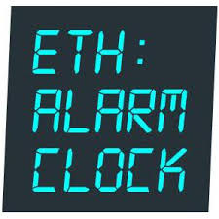
Pattern 13: Security Deposit 3/3
Related Patterns
Pattern 18. Incentive Execution
Known uses
Deposit used in Bitcoin contract
Party with no reputation provides deposit as a proof of trustworthiness
Slock.it requires servers to pay a deposit
Lost in case of a wrong response
Incentivize cross-checking as watchdog
Ethereum alarm clock enables scheduling of transactions for delayed execution in the future
Deposit is required to claim a request
Return if the claimer fulfills the commitment to execute the request
Given to someone else that executes the request as an additional reward
Notes:
The notion of “deposits” has already been used in Bitcoin’s contract, where deposit is bought by a party with no reputation as a proof of her trust.
Slock.it requires the servers to pay a deposit which they would lose if they give a wrong response.
Such security deposit also incentivise other servers to check each others’ responses, and act as watchdogs.
Ethereum alarm clock enables scheduling of transactions for delayed execution in the future.
Before the execution window, there is a claim window when the request may be claimed by a participant for execution.
To claim a request, the participant is required to put down a deposit. If the claimer fulfils their commitment to execute the request, the deposit is returned to them, otherwise, the deposit is given to someone else that executes the request as an additional reward.

Slide 62
Student Task
Take 30 seconds to think about applying this pattern for any use case you know about
Maybe exam registration?
Then we’ll discuss

Slide 63
Related Patterns
Pattern 3.
Voting
Pattern 12.
X-Confirmation
Support
Pattern 10.
Multiple Authorization
Pattern 13.
Security Deposit
Authority is unknown
Support
Pattern 11.
Dynamic Authorization
Pattern 18.
Incentive Execution
Notes:
Multiple authorization is very relevant to dynamic authorization
Dynamic authorization is more dynamic than multiple authorization, where the possible authorities are pre-defined
Multiple authorization can be a technical solution for voting
Security deposit can be used to implement incentive execution

Slide 64
Blockchain-based Application Pattern Collection: Contract Structural Patterns

Slide 65
Pattern Collection (Chapter 7)
Interaction with External World
Centralized Oracle
Decentralized Oracle
Data Management
Encrypting On-chain Data
Voting
Tokenisation
Security
Multiple Authorization
X-confirmation
Security Deposit
Contract Structural Patterns
Contract Registry
Embedded Permission
Data Contract
Factory Contract
Incentive Execution
Deployment
Semi-dapp
dapp
Legal and Smart Contract Pair
Reverse Oracle
Off-chain Data Storage
State Channel
Dynamic Authorization
Mixed on and off-chain
Purely on-chain
Notes:
Overview of pattern collections in five categories, including
On-chain and off-chain is the fundamental design decision
Oracles are offchain, legal and smart contract pair on chain
One by one discuss

Slide 66
Overview
Smart contracts are programs running on blockchain
Design patterns and programming principles for conventional software are in principle applicable
Structural design of the smart contract has large impact on its execution cost
Monetary cost on public blockchain
Cost of data storage
Throughput inversely proportional to complexity / size
Structural designs of smart contracts may affect performance
More or fewer transactions may be required
Notes:
This section discusses five smart contracts patterns.
Essentially, smart contracts are programs running on blockchain, thus some of the existing design patterns and programming principles for conventional software environments are also applicable to smart contracts.
If a public blockchain is used, the structural design of the smart contract has large impact on its execution cost.
The cost of deploying a smart contract depends on the size of the smart contract(s) because the code is stored on blockchain, resulting in a data storage fee that is proportional to the size of the smart contract.
Thus, a structural design with more lines of compiled code costs more money.
A consortium blockchain does not necessarily have tokens/currency; therefore monetary cost is typically not an issue for a consortium blockchain.
However, blockchain size is still a design concern because the total size of the blockchain keeps growing as more blocks are appended to it and no block can ever be detached from it, and every participant stores a full replica of blockchain.
Besides, different structural designs of smart contracts may affect performance because more or less transactions may be required.

Slide 67
Pattern 14: Contract Registry 1/3
Summary
Before invoking a smart contract, the address of the latest version of the smart contract is located by looking up its name on a contract registry
Context
Blockchain-based applications may need to be upgraded to new versions
Fix bugs or fulfill new requirements
Problem
Smart contract cannot be upgraded because they are immutably stored on blockchain
Forces
Immutability
On-chain contract code is immutable
Upgradability
Fundamental need to upgrade smart contract
Human-readable contract identifier
Hexadecimal address is not human-readable
Notes:
Context: As any software application, blockchain-based applications need to be upgraded to new versions. To do so, the on-chain functions defined in smart contracts need to be updated to fix bugs as well as to fulfil new requirements.
Problem: Smart contracts deployed on blockchain cannot be upgraded because the code of the smart contracts as a type of data, stored on blockchain is immutable.
The problem requires to balance the following forces:
Immutability. Every bit of data, including deployed smart contracts, stored on blockchain is immutable.
Upgradability. There is a fundamental need to upgrade all but short-lived applications and their smart contracts over time.
Human-readable contract identifier. The identifier of a smart contract on blockchain platforms, like Ethereum, is hexadecimal address, which is not human-readable.

Slide 68
Pattern 14: Contract Registry 2/3
Solution
On-chain registry contract maintains a mapping between user-defined names and contract addresses
Registry contract address is publicized off-chain
Invoker retrieves the latest version from registry
Or registry forwards call to the latest version contract
Upgrade contract by replacing the old contract address with new contract address in the registry
Consequences
Benefits
Human-readable contract name
Constant contract name
Transparent upgradability
Version control: Look-up based on name and version
Drawbacks
Limited upgradability: modifying interfaces is challenging if used by external components, or limited if forwarding is used
Cost: Additional cost to maintain the registry
Notes:
Solution: An on-chain registry contract is used to maintain a mapping between user-defined symbolic names and the blockchain addresses of the registered contracts.
The address of the registry contract needs to be advertised off-chain. The creator of a contract can register the name and the address of the new contract to the registry contract after the new contract being deployed.
The invoker of a registered contract retrieves the latest version of the new smart contract from the registry contract.
The corresponding functions provided by the registered contract can be upgraded by replacing the address of the old version contract in the registry contract with the address of a new version without breaking the dependency between the upgraded smart contract and other smart contracts that depend on its functions.
The address of a contract is stored as a variable in the registry contract. The value of contract variables can be updated. The registry contract can have a permission control module to maintain the writing permission. Note that all the previous values of the variable are still stored on the blockchain.
Human-readable contract name. The registry contract maintains a mapping between human-readable names and the hexadecimal addresses of the smart contracts.
A human readable form of smart contract names is desired, for example, to be exposed to the user interface. A human readable name is also useful for developers.
Constant contract name. The smart contract associated with a registered name can be updated without changing its name. This way dependencies relying on the name of the smart contract do not get broken.
Transparent upgradability. The smart contract associated with a registered name could be replaced by a new version without breaking the dependencies based on the human-readable name.
Version control. Version control can be integrated in the registry contract as well to allow a look-up based on the name and version of a smart contract. Old versions of a smart contract that are no longer needed should be terminated.
Drawbacks:
Limited upgradability. Upgradability is still limited if the functions defined in the smart contract are called by other contracts. Although the implementation of the function can be upgraded, the interface (that is function signature) cannot be modified without breaking the link to dependent smart contracts.
Similar methods as for API / service interface management need to be implemented, e.g. through versioning and depreciation flags.
Cost. There is an additional cost to maintain a registry that contains the mapping between the contract names and their addresses.
Furthermore, all the inter-contract function calls require a registry look-up to find the latest version of the smart contract to be invoked.

Slide 69
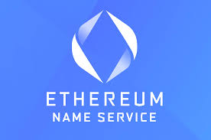

Pattern 14: Contract Registry 3/3
Related Patterns
Pattern 15. Data Contract
Pattern 16. Embedded Permission
Known uses
ENS (Ethereum Name Service)
Supports registering both smart contract and off-chain resources
Contract registry accessible to everyone
Blockchain-based application can maintain a registry for the application
Regis
In-browser application for registry deployment and management
Allows user-defined key-value pairs for creating a contract registry
Notes:
ENS is a name service on Ethereum blockchain, which is implemented as smart contracts.
ENS maintains a mapping between both smart contracts on-chain and resources off-chain and simple, human-readable names.
ENS can be viewed as a contract registry built in a blockchain platform, which is accessible to everyone. A blockchain-based application can also maintain a separate registry contract for the application.
Regis is an in-browser application that makes it easy to build, deploy and manage registries as smart contracts on Ethereum blockchain.
It allows user-defined key-value pairs. It can be used to create a contract registry.

Slide 70
Student Task
Take 30 seconds to think about applying this pattern for any use case you know about
Maybe exam registration?
Then we’ll discuss

Slide 71
Pattern 15: Data Contract 1/3
Summary
Store data in a separate smart contract
Context
Upgrading an application and its smart contract over time is often necessary
Logic and data change at different times and with different frequencies
Problem
Copying large amounts of data from old to new contract is very costly and not very efficient
Lots of little pieces of data add up quickly
Porting data to new version might require multiple (or even many) transactions
Forces
Coupling: the data stored in a deactivated contract is not accessible through SC functions
Upgradability: the ability to upgrade application and smart contract often becomes necessary over time
Cost: copying data from old contract to new contract has extra cost
Notes:
Context: The need to upgrade a blockchain-based application over time is ultimately necessary, so as the smart contracts used by the application.
In general, logic and data change at different times and with different frequencies.
Problem: Storing data on blockchain is expensive and there is a limitation on the amount of data and amount of computation a transaction can contain.
In the context of upgrading smart contracts, the upgrading transactions might contain a large data storage for copying the data from the old version of the smart contract to the new version of the smart contract.
Porting data to a new version might even require multiple transactions, e.g. when the block gas limit on Ethereum prevents an overly complex data migration transaction.
Forces: The problem requires to balance the following forces:
Coupling. Smart contracts can live forever on blockchain if not being explicitly terminated.
If a smart contract is deactivated in this way, the data stored in the smart contract cannot be accessed through the smart contract functions any more
although it can still be accessed with some effort, e.g. for provenance or audit purposes.
Upgradability. The need to upgrade the application and the smart contracts supporting the application over time is ultimately necessary for many applications.
Cost. If a public blockchain is used, storing data on blockchain costs money. Thus copying data from an old version of a smart contract to a new version should be avoid or minimized.

Slide 72
Pattern 15: Data Contract 2/3
Solution
Data store is isolated from the rest of the code
Avoid moving data during upgrades of smart contracts
Strict definition or a loosely typed flat store
Depends on data store size and change frequency
More generic and flexible data structure can be used by other contracts
Less likely to require changes
Consequences
Benefits
Upgradability: dapp logic can be upgraded without affecting the data
Cost: no cost for migrating data when the logic is upgraded
Generality: generic separated data contract can be used by multiple smart contracts
Drawbacks
Cost on public blockchain: generic data structure might cost more than a strictly defined data structure
Cost of generality: querying data is less straightforward
Notes:
Solution: To avoid moving data during upgrades of smart contracts, the data store is isolated from the rest of the code.
In the context of blockchain, data could be separately stored in different smart contracts to enable isolation.
Depending on the circumstances of the application, how large of a data store it needs and whether the data structure is expected to change often, the data store could use a strict definition or a loosely typed flat store.
The more generic and flexible data structure can be used by all the other logic smart contracts and is unlikely to require changes. One example of a generic data structure is a mapping to store SHA3 key and value pairs.
Benefits:
Upgradability. By separating data from the rest of the code, the logic of the application is able to be upgraded without affecting the data contract.
Cost. Since the data is separated from the rest of the code, there is no cost for migrating data when the application is upgraded.
Generality. If the data can be cleanly separated and generalized, there would be an additional benefit: the generic data contract can be used by all related logic smart contracts.
Cost. If a public blockchain is used, storing a piece of data in a generic data structure costs more money than a strictly defined data structure. For example, as mentioned earlier, a generic data structure maintains a mapping between SHA3 key and value pairs, but a more strictly defined data structure can be of smaller size, e.g. not requiring the key to be stored. Querying the data is also less straightforward. This is the cost of a generalized solution.

Slide 73


Pattern 15: Data Contract 3/3
Related Patterns
Pattern 14. Contract Registry
Known uses
Chronobank
Tokenize labour
Market for professionals to trade labour time with businesses
A generic data store using a mapping of SHA3 key and value pairs
Colony
Ethereum-based platform for open organizations
A generic data store using a mapping of SHA3 key and value pairs
Notes:
Chronobank is a blockchain project that tokenizes labour and provides a market for professionals to trade their labour time with businesses.
It uses a smart contract with a generic data structure as the data store used by all the other logic smart contracts.
Colony, a platform for open organizations running on Ethereum. Similar to Chronobank, Colony has a data contract with a generic data structure.

Slide 74
Student Task
Take 30 seconds to think about applying this pattern for any use case you know about
Maybe exam registration?
Then we’ll discuss

Slide 75
Pattern 16: Embedded Permission 1/3
Summary
Smart contracts use embedded permission control to restrict access to the invocation of the functions
Context
All smart contracts can be accessed and called by all the participants of a blockchain system and other smart contracts
No privileged users
Problem
Permission-less function can be triggered by unauthorized users (accidentally)
Permission-less function becomes vulnerability
E.g., a permission-less function used by Parity multi-sig wallet caused freezing of 500K Ether
Forces
Security
Smart contract is publically available for everyone to invoke
Internal logic in conventional software system is normally invisible to end users
API/Interface can enforce access control policies
Notes:
Context: All the smart contracts running on blockchain can be accessed and called by all the blockchain participants and other smart contracts by default,
Because there are no privileged users and, in the case of public blockchain, every participant can join the network to access all the information and code stored and running on blockchain.
Problem: A smart contract by default has no owner, meaning that once deployed the author of the smart contract has no special privilege on the smart contract.
A permission-less function can be triggered by unauthorized users accidentally.
Such a permission-less function becomes vulnerability of blockchain-based application.
For example, a permission-less function which is discovered in a smart contract library used by the Parity multi-sig wallet, caused the freezing of about 500K Ethers
smart contract on public Ethereum can be terminated without authority.
Security. The functions defined in the smart contracts should be called only by the authorized participants.
Due to the transparency of public blockchains, all the smart contracts are also publicly available to everyone connecting to the Internet.
In contrast, in a conventional software system, the internal logic is normally not visible to the end uses. I
nteraction with the software system is either through a user interface or API, where it is possible to enforce access control policies.

Slide 76
Pattern 16: Embedded Permission 2/3
Solution
Adding permission control at the start of every smart contract function
Check authorization of the caller before execution of the core function
Check permission based on blockchain addresses
Unauthorized calls are rejected
Consequences
Benefits
Security
Only authorized participants can successfully call functions
Secure authorization
Authorization leverages blockchain properties
Drawbacks
Cost
Additional deployment and run-time cost on public blockchain
Lack of flexibility
Permissions are defined before deployment
Mechanism needed to support dynamic granting and removal of permissions
Notes:
Solution: Adding permission control to every smart contract function to check permissions for every caller that triggers the functions defined in the smart contract based on the blockchain addresses of the caller.
This can be done by checking the authorization of the caller before executing the logic of the function: unauthorized calls are rejected and the execution of the function terminated before reaching the core logic of the function.
Security. Only the participants and smart contracts that are authorized by the smart contract can call the corresponding functions successfully.
Secure authorization. Authorization is implemented in smart contracts running on blockchain, which leverages the properties provided by blockchain.
Cost. On a public blockchain, extra code that implements the permission control mechanism also has additional deployment and run-time cost.
Lack of flexibility. Such permissions are defined in the smart contract before its deployment, therefore they are difficult to change.
However, permissions may be required to be dynamic. A mechanism is needed to support dynamic granting and removal of permissions.

Slide 77
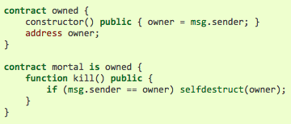
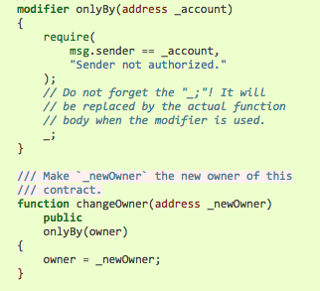
Pattern 16: Embedded Permission 3/3
Related Patterns
Pattern 10. Multiple Authorization
Pattern 11. Dynamic Authorization
Known uses
Mortal contract on Ethereum
Restricts the permission of invoking the self-destruct function to the contract owner
Restrict access pattern on Ethereum
Uses modifier to restrict who can call the functions
Modifier add a piece of code before the function to check certain conditions
Modifier makes such restrictions highly readable
Notes:
The Mortal contract discussed in the Solidity tutorial restricts the permission of invoking the self-destruct function to the “owner” of the contract
where “owner” is a variable defined in the contract code itself.
The Restrict access pattern suggested in the Solidity tutorial uses modifier to restrict who can make modifications to the state of the contract or call the functions of the contract.
Modifier is a mechanism to add a piece of code before the function to check certain conditions. Modifier can make such restrictions highly readable.

Slide 78
Student Task
Take 30 seconds to think about applying this pattern for any use case you know about
Maybe exam registration?
Then we’ll discuss

Slide 79
Pattern 17: Factory Contract 1/3
Summary
On-chain template contract is used as a factory that generates contract instances from the template
Context
Application might need to use multiple instances of a standard contract with customization
Contract instance is created by instantiating a contract template
Stored off-chain in a code repository or on-chain within its own smart contract.
Problem
Off-chain contract template cannot guarantee consistency between different SC instances
Forces
Dependency management: Storing smart contract off-chain introduces more components
Secure code sharing: Blockchain is a secure platform for sharing contract code
Deployment: Extra effort is needed to deploy a smart contract from off-chain source code
Notes:
Context: Applications based on blockchain might need to use multiple instances of a standard contract with customization.
Each contract instance is created by instantiating a contract template.
For example, in a business process management system, each of the business process instances might be represented by a smart contract being generated from a contract template representing the business process model.
The template can be stored off-chain in a code repository, or on-chain, within its own smart contract.
Problem: Keeping the contract template off-chain cannot guarantee consistency between different smart contract instances created from the same template
because the source code of the template can be independently modified.
Dependency management. Storing the source code of smart contract off-chain in a code repository introduces the issue of integrating more systems into the blockchain-based application.
Secure code sharing. Blockchain can be used as a secure platform to share code of smart contracts.
As opposed to a traditional code repository, changes of code deployed on a smart contract can be strictly limited or prohibited.
Deployment. If a public code repository, like Github, is used to store the source code of a smart contract, a component is needed to implement the function of deploying smart contract on blockchain, otherwise, the end users need to understand how to deploy smart contracts by sending transactions with the customized source code of the contract definition.

Slide 80
Pattern 17: Factory Contract 2/3
Solution
Smart contracts are created from on-chain factory contract
Factory contract is deployed once from off-chain code
Smart contract instances are generated by passing parameters to the factory to instantiate individual contracts
SC instance maintain its properties and state independently of other instances
Consequences
Benefits
Security: On-chain factory contract on-chain guarantees consistency
Efficiency: Smart contract instances are generated by calling a function
Drawbacks
Cost on public blockchain
Deployment
Function call for instance creation
Notes:
Solution: Smart contracts are created from a contract factory deployed on blockchain.
The factory contract is deployed once from the off-chain source code.
The factory may contain the definition of multiple smart contracts.
Smart contract instances are generated by passing parameters to the contract factory to instantiate customized smart contract instances.
Factory contract is analogous to a Class in an object-oriented programming language. Every transaction that generates a smart contract instance essentially instantiates an object of the factory contract class.
This contract instance (the object) will maintain its own properties independently of the other instances but with a structure consistent with its original template.
Security. Keeping the factory contract on-chain guarantees the consistency of the contract definition.
Efficiency. If the contract definition is kept on-chain in a factory contract, smart contract instances are generated by calling a function defined in the factory contract.
Drawbacks:
Deployment cost. If a public blockchain is used, using factory contract requires extra cost to deploy the factory contract.
Function call cost. If a public blockchain is used, creating a new smart contract instance requires extra cost to call a function defined in the factory contract.

Slide 81
Pattern 17: Factory Contract 3/3
Related Patterns
Pattern 14. Contract registry
Known uses
Tutorial from Ethereum developer
Create a contract factory
*Being applied in a real-world blockchain-based health care application
**A business process management system uses a contract factory to generate process instances
*Zhang, P., White, J., Schmidt, D.C., Lenz, G.: Applying Software Patterns to Address Interoperability in Blockchain-based Healthcare Apps (Jun 2017)
**Weber, I., Xu, X., Riveret, R., Governatori, G., Ponomarev, A., Mendling, J.: Untrusted business process monitoring and execution using blockchain.
In: BPM. pp. 329–347. Springer, Rio de Janeiro, Brazil (Sep 2016)
Notes:
A tutorial from Ethereum developers about how to create a contract factory from which smart contract instances can be created.
Factory pattern has been applied in a real-world blockchain-based health care application.
The business process management system in an academic work [18] uses a contract factory to generate process instances.

Slide 82
Student Task
Take 30 seconds to think about applying this pattern for any use case you know about
Maybe exam registration?
Then we’ll discuss

Slide 83
Pattern 18: Incentive Execution 1/3
Summary
Reward is provided to the caller of the contract function for invoking the execution
Context
Smart contracts are event-driven
Accessorial functions need to run asynchronously from regular user interaction
Clean up the expired records or make dividend payouts
Start after a defined time
Problem
Users normally have no direct benefit from calling accessorial functions
Extra monetary cost to call accessorial functions
Forces
Completeness: Regular services are supported by accessorial functions
Cost: Execution of accessorial functions causes extra cost from users
Notes:
Context: Smart contracts are event-driven programs, which cannot execute autonomously.
All the functions defined in a smart contract need to be triggered either by a transaction from external account or another smart contract to execute.
Other than the functions that provide regular services to users, some functions need to run asynchronously from regular user interaction, for example, to clean up the expired records, or make dividend payouts etc.
Such functions usually involve a time, after which the function should start.
Problem: Users of a smart contract have no direct benefit from calling the accessorial functions.
If a public blockchain is used, executing these functions causes extra monetary cost. Some accessorial functions are expensive to execute.
Completeness. The regular services provided by a smart contract are supported by some accessorial functions.
Cost. Execution of accessorial functions causes extra costs from the users.

Slide 84
Pattern 18: Incentive Execution 2/3
Solution
Reward the caller of a function defined in a smart contract for invoking the function
E.g., sending back a percentage of payout to the caller to reimburse the (gas) execution cost
Consequences
Benefits
Completeness: Execution of accessorial functions helps to complete the regular services
Cost: The caller is compensated by the reward associated with the execution
Drawbacks
Unguaranteed execution
Execution cannot be guaranteed even with incentive
Embed the logic of accessorial functions into other regular functions
Notes:
Solution: Reward the caller of a function defined in a smart contract for invoking the execution, for example, sending back a percentage of payout to the caller to reimburse the (gas) execution cost.
Completeness. The execution of the accessorial functions helps to complete the regular services provided by the smart contract.
Cost. The users, who spends extra to execute the accessorial functions, are compensated by the reward associated with the execution.
Drawbacks:
Unguaranteed execution. Execution cannot be guaranteed even with incentive.
Thus, another option is to embed the logic of accessorial functions into other regular functions that users have to call to use the services.

Slide 85
Pattern 18: Incentive Execution 3/3
Related Patterns N/A
Known uses
Regis
In-browser tool to create smart contract registries
Incentivize users to execute functions that clean up the expired records
Ethereum alarm clock facilitates scheduling function calls for a specified block in the future
Provide incentive for users to execute the scheduled functions
Notes:
Regis is an in-browser tool for developers to create smart contracts representing registries on Ethereum.
The functions that clean up the expired records provide incentive for users to execute them.
Ethereum alarm clock is a service provided by a smart contract running on Ethereum.
It facilitates scheduling function calls for a specified block in the future and provides incentive for users to execute the scheduled function.

Slide 86
Student Task
Take 30 seconds to think about applying this pattern for any use case you know about
Maybe exam registration?
Then we’ll discuss

Slide 87
Related Patterns
Pattern 10.
Multiple Authorization
Pattern 16.
Embedded Permission
Support
Pattern 11.
Dynamic Authorization
Support defining
write permission
Pattern 14.
Contract Registry
Pattern 15.
Data Contract
Register new
smart contract instances
Work together to
improve upgradability
Pattern 17.
Factory Contract
Pattern 18.
Incentive Execution
Notes:
Contract registry provides registry for smart contract
Factory contract create new contract instance, and register the new instance to contract registry
Embedded permission add permission to contract registry
Data contract works with the created smart contract to improve upgradability
Multiple authorization and dynamic authorization can support the permission control

Slide 88
Blockchain-based Application Pattern Collection: Deployment

Slide 89
Pattern Collection (Chapter 7)
Interaction with External World
Centralized Oracle
Decentralized Oracle
Data Management
Encrypting On-chain Data
Voting
Tokenisation
Security
Multiple Authorization
X-confirmation
Security Deposit
Contract Structural Patterns
Contract Registry
Embedded Permission
Data Contract
Factory Contract
Incentive Execution
Deployment
Semi-dapp
dapp
Legal and Smart Contract Pair
Reverse Oracle
Off-chain Data Storage
State Channel
Dynamic Authorization
Mixed on and off-chain
Purely on-chain
Notes:
Overview of pattern collections in five categories, including
On-chain and off-chain is the fundamental design decision
Oracles are offchain, legal and smart contract pair on chain
One by one discuss

Slide 90
Pattern 19: dapp 1/3
Summary
Decentralized applications(dapps) are applications running on P2P network
Dapp offers websites that allow users to interact with smart contracts
Context
Users interacting with smart contracts through sending transactions to call smart contract
Source code of the smart contract should be open source (to participants)
ABI (application binary interface) should be publicly accessible
Problem
Strong technical understanding of blockchain and smart contract is required
Error-prone process with a bad user experience
Forces
Learning Curve: Read source code →understand smart contract → interact with smart contract
Convenience: Manually generating transaction is a error-prone process
Notes:
Summary: Decentralized applications(dapps) are applications running on P2P network rather than a single computer. dapps are blockchain-based websites that allow users to interact with smart contracts deployed on blockchain.
Context: Users interact with smart contracts through sending transactions to invoke the functions defined in smart contracts.
In order for the users to interact with a smart contract, the source code of the smart contract should be open source.
Second, the application binary interface (ABI) of the smart contract should be publicly accessible.
Problem: Users need a strong technical understanding of blockchain and smart contract to be able to generate transactions calling smart contracts. Such process is error-prone and with a bad user experience.
Learning Curve. Users need to understand the functionality of a smart con-tract before being able to interact with it.
To understand the smart contract, users need to read the source code of smart contract.
– Convenience. Even with an understanding of the smart contract, manually generating transactions is a error-prone process.

Slide 91
Pattern 19: dapp 2/3
Solution
Front-end for users to interact with smart contract
Hosted on a decentralized storage
E.g., IPFS
Rendered by dapp browsers or plug-ins to web browser
E.g., Ethereum Mist or MetaMask
Transactions calling SC are generated by dapp
User verifies transactions before sending to blockchain
Consequences
Benefits
Convenience: User experience of using front-end is much better than manually generating transactions
Drawbacks
Trust
Requires certain trust in the dapp provider
Impact of the transaction execution is not explicit without understanding the smart contract
Learning Curve: Require basic technical knowledge regarding transactions and smart contracts
Notes:
Solution: dapp provides a front-end for users to easily interact with smart contracts.
The frond end uses the same technology as conventional web application to render web pages.
The difference is that dapps are hosted on a decentralized storage, like IPFS, and are rendered by dapp browsers, like Ethereum Mist or a plug-in to a web application browser, like MetaMask.
The transactions calling smart contracts are generated by dapps, and are presented to the users for further verification before being sent to the blockchain.
Convenience. Users interact with smart contract through a front-end provided by the dapp provider. The user experience of using the frontend of a dapp is much better than manually generating transactions to interact with smart contracts.
Trust. Using dapps requires a certain trust in the dapp provider because the transactions are generated by the dapp. However, the impact of the execution is not explicit without understanding the underneath smart contracts, especially if the source code of the contract or ABI is not published.
Learning Curve. Some basic technical knowledge regarding transactions and gas prices is still required by users to use dapps and verify the transactions generated by the dapps.

Slide 92
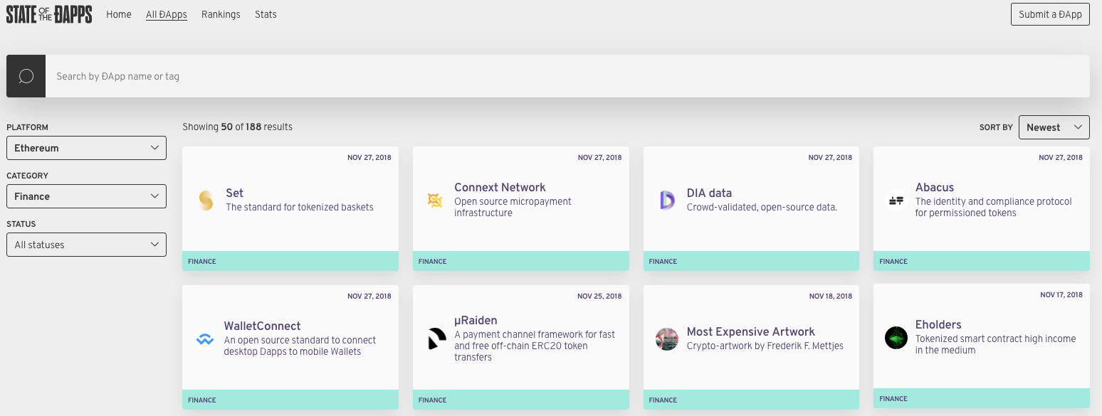
Pattern 19: dapp 3/3
Known uses
State of the dapp
Directory of dapps on Ethereum
1800+ dapps with different levels of maturity
Related Patterns
Pattern 20. Semi-dapp
https://www.stateofthedapps.com/

Slide 93
Pattern 20: Semi-dapp 1/3
Summary
Dapp provider offers a website that can be browsed using a conventional web browser
Context
Interacting with smart contracts through sending transactions to invoke execution
Source code of the smart contract should be open source (to participants)
ABI (application binary interface) should be publicly accessible
Problem
Even with a front-end, basic knowledge regarding transactions and gas prices are required
Use dapp and verify the transactions generated by dapp
Forces
Learning Curve: Users need basic knowledge of smart contracts in order to use dapp
User Experience
Front-end of most dapps is quite simple
Exposes some technical detail of the underlying smart contract
Notes:
Summary: dapp provider offers a website, which can be browsed using a conventional web browser without any dapp plugin (like MetaMask).
Context: Users interact with smart contracts through sending transactions to invoke the functions defined in smart contracts.
Users need to understand the functionality of a smart contract to be able to interact with the smart contract.
Thus, the source code of the smart contract should be open source and the application binary interface (ABI) of the smart contract should be publicly accessible.
Problem: Users need a strong technical understanding of blockchain and smart contract to be able to generate transactions and interact with smart contracts.
Such process is error-prone, with a bad user experience. Even with a front-end that assists the user to interact with smart contracts,
some basic technical knowledge regarding transactions and gas prices is still required by users to use dapps and verify the transactions generated by the dapps.
Learning Curve. Users need some basic technical knowledge of smart contracts in order to use dapps.
User Experience. Due to the decentralization nature of dapps, the frontend of most dapps is quite simple, and exposes some technical detail of the underneath smart contract, which doesn’t have to be known by the users.

Slide 94
Pattern 20: Semi-dapp 2/3
Solution
Front-end for users to interact with smart contract
Rendered by Web browsers
Website communicates with the dapp backend through RESTful API calls
Backend is responsible for interacting with the smart contracts on behalf of the user
Consequences
Benefits
Convenience: User experience is as same as conventional web applications
Drawbacks
Trust
Requires complete trust in the dapp provider
dapp provider manages the private keys of users
For transparency, need to check the execution of the transactions sent by the dapp through an official blockchain explorer or blockchain node
Notes:
Solution: dapp provider offers a website for users to easily interact with smart contracts.
The website uses the same technology as conventional web application to render web pages, where the technical details of the underneath smart contracts are opaque to the users.
The website communicates with the dapp backend through RESTful API calls.
Thus, the backend is responsible for interacting with the smart contracts on behalf of the user, who is not able to validate the transactions being sent to the blockchain.
Convenience. Users interact with smart contract through a web site provided by the dapp provider.
The user experience of using the front-end of such a dapp is as same as using the front-end of a conventional web application.
Trust. Users need to completely trust the dapp provider who is responsible for managing their private keys.
One example is a Japan-based Bitcoin . exchange, Mt. Gox65. Launched in 2010, Mt. Gox used to be the largest Bitcoin exchange in the world, which handles over 70% of all Bitcoin transactions worldwide. In June 2011, Mt. Gox announced that approximately 850,000 Bitcoins (an amount valued at more than $450 million at the time) belonging to customers and the company disappeared, most likely due to a compromised internal computer.
One security strategy for the users is to check the execution of the transactions sent by the dapp [19] through an offical blockchain explorer, like Etherscan66.

Slide 95
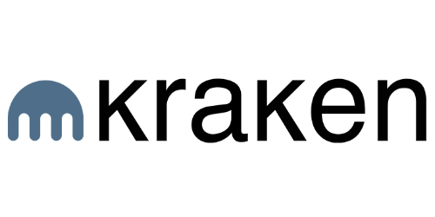

Pattern 20: Semi-dapp 3/3
Related Patterns
Pattern 19. dapp
Known uses
Cryptocurrency Exchanges
Kraken
San Francisco-based Bitcoin exchange
Binance
China-based cryptocurrency exchange
Notes:
– Cryptocurrency exchanges are common examples of this patterns as they always interact with the blockchain on behalf of the users. Kraken is a San Francisco-based Bitcoin exchange.
– Binance is a cryptocurrency exchange founded in China.

Slide 96
Student Task
Take 30 seconds to think about applying the previous two patterns for any use case you know about
Maybe exam registration?
Which is more suitable?
Then we’ll discuss

Slide 97
Related Patterns
Manual interaction with smart contract
Certain trust to the dapp provider
More convenient, less learning required
Pattern 19.
dapp
Complete trust to the dapp provider
Pattern 20.
Semi-dapp
Notes:
Three possible ways to interact with smart contracts
From manual to dapp to semi-dapp, more trust is required to the dapp provider

Slide 98
Decision Models for Choosing Pattern
Content from recent paper: Decision Model for Choosing Patterns in Blockchain-Based Applications
Xiwei Xu, H.M.N. Dilum Bandara, Qinghua Lu, Ingo Weber, Len Bass, and Liming Zhu
The 18th IEEE International Conference on Software Architecture (ICSA2021), March 2021
https://www.researchgate.net/publication/349412778_A_Decision_Model_for_Choosing_Patterns_in_Blockchain-Based_Applications

Slide 99
Blockchain Patterns
Pattern Selection is Non-trivial
Limited information about relationship among patterns
Fragmented trade-off analysis

Slide 100
Methodology
Model Creation
Identify selection paths based on related patterns
Evaluation
Interviews with six domain experts
Derive Quality impacts and trade-offs from forces and consequences
3 from academia
3 from industry
Model Refinement
More precise explanations of quality trade-offs
Improve definition of graphical notation

Slide 101
Design Process of Blockchain Applications

Slide 102
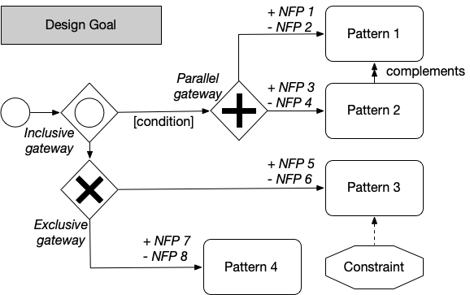
Decision Model Notation

Slide 103
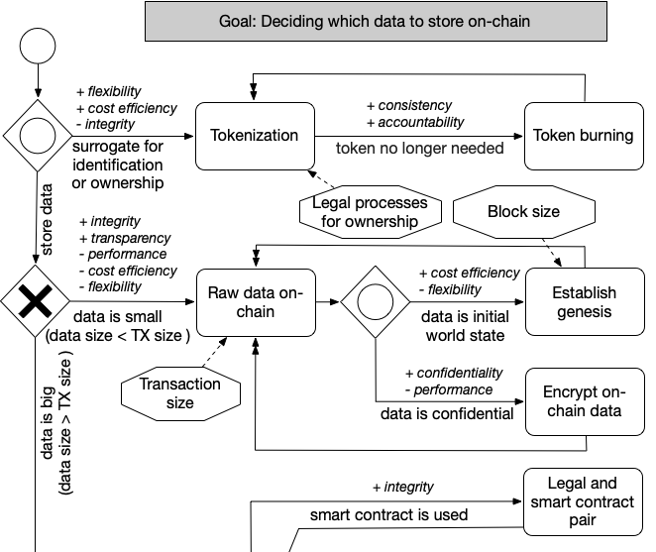
Data Management: On-chain
Encrypting on-chai data
Establish genesis
Legal and smart contract pair
Raw data on-chain
Tokenization
Token burning
Main quality measures
Integrity
Consistency
Transparency
Performance
Cost efficiency

Slide 104
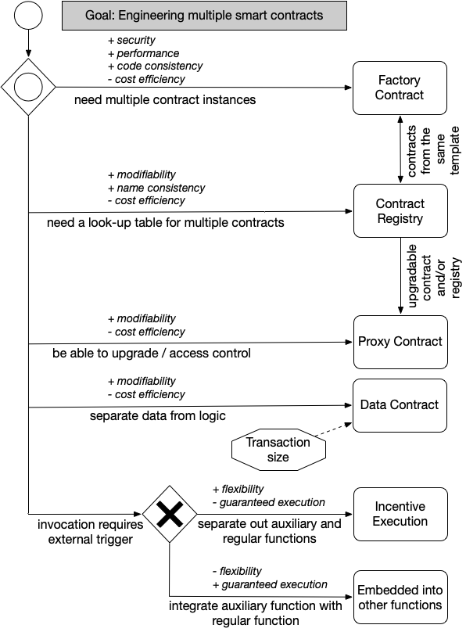
Smart Contract
Factory contract
Contract registry
Proxy contract
Data contract
Incentive execution
Embedded into other functions
Main quality measures
Performance
Security
Cost efficiency
Modifiability
Consistency

Slide 105
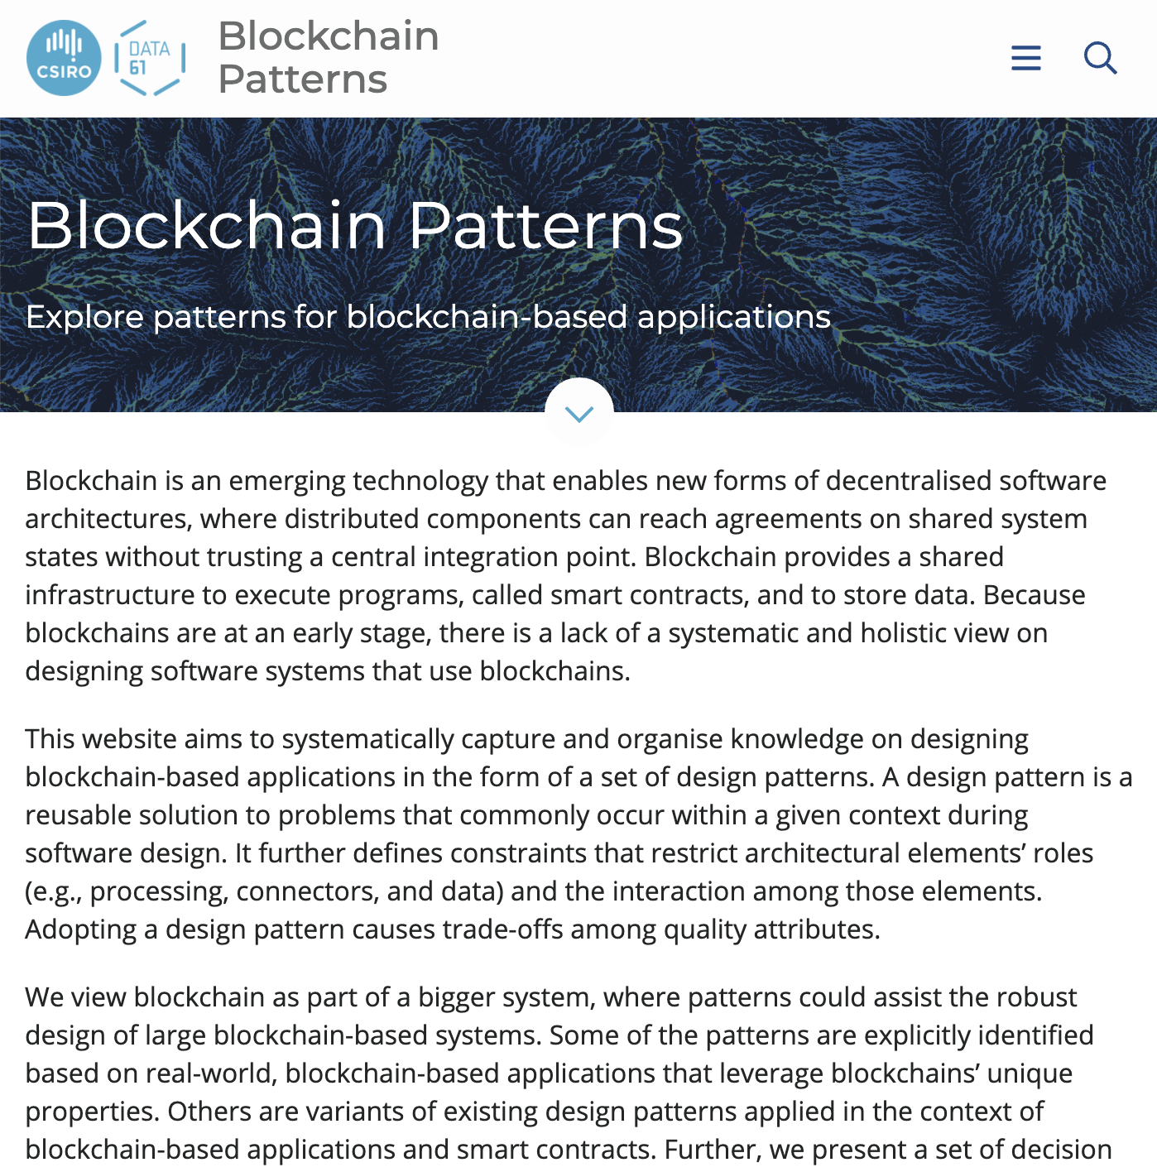
Summary of decision models
Decision models that assist developers and architects in selecting patterns for blockchain-based applications
2 shown, more available
Future work
On-line decision tool
Collect feedback through the pattern website to improve the decision models iteratively
https://research.csiro.au/blockchainpatterns/

Slide 106
Summary: Blockchain-based Application Pattern Collection

Slide 107
Summary 1/2
Interaction with External World
Data Management
Security
Centralized Oracle
Decentralized Oracles
Voting
Reverse Oracle
Legal and smart contract pair
Introducing external state into the blockchain environment through a centralized oracle
Introducing external state into the blockchain environment through decentralized oracles
A method for a group of blockchain users to make a collective decision
A method for a group of blockchain users to make a collective decision
A bidirectional binding between a legal agreement and the corresponding smart contract that codifies the legal agreement
Encrypting On-chain Data
Tokenisation
Off-chain Data Storage
State Channel
Ensuring confidentiality of the data stored on blockchain by encrypting it
Using tokens on blockchain to represent transferable digital or physical assets or services
Using hashing to ensure the integrity of arbitrarily large datasets which may not fit directly on the blockchain
Transactions that are too small in value or that require much shorter latency, are performed off-chain with periodic recording of net transaction settlements on-chain
Multiple Authorization
Dynamic authorization
X-Confirmation
Security Deposit
Transactions are required to be authorized by a subset of the pre-defined addresses
Using a hash created off-chain to dynamically bind authority for a transaction
Waiting for enough number of blocks as confirmation to ensure that a transaction added into blockchain is immutable with high probability
A deposit from a user, which will be paid back to the user for her honesty or given to others to compensate them for the dishonesty of the user

Slide 108
Summary 2/2
Structural Patterns of Contract
Deployment
Contract Registry
Embedded Permission
Data Contract
Factory Contract
Incentive Execution
The address, and the version of the smart contract is stored in a contract registry
Embedded permission control is used to restrict access to the invocation of the functions defined in the smart contracts
Storing data in a separate smart contract
An on-chain template contract used as a factory that generates contract instances from the template
A reward to the caller of a contract function for invocation
Dapp
Semi-dapp
Blockchain-based application hosted on P2P network, with a website that allows users to interact with smart contracts
Blockchain-based application with a website that can be browsed using a conventional web browser without any dapp plugin

Slide 109
Design Patterns (Details)
Source of most materials:
Xiwei Xu, Ingo Weber, and Mark Staples. Architecture for Blockchain Applications. Springer, 2019

